Slide 1
Wellness Policy Assessment and Evaluation: Much Ado’s about the Need To Do’s
School Wellness Summit
Santa Barbara County
October 24, 2018

Slide 2
What is your Wellness vision?

Slide 3
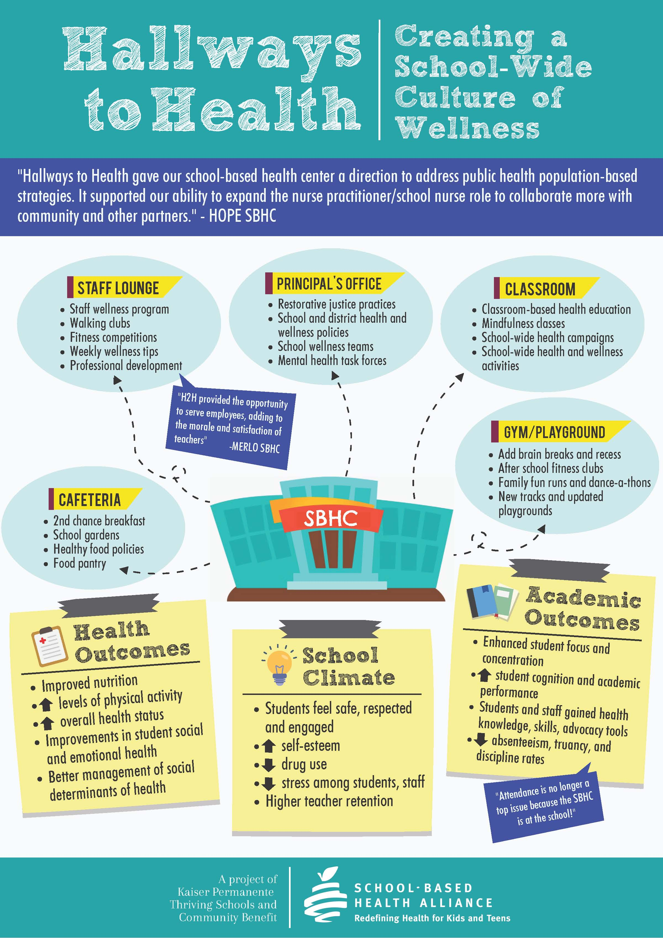
What is your Wellness vision?
www.sbh4all.org/current_initiatives/
hallways-to-health/

Slide 4
Agenda
Administrative Review
Food and Beverage Marketing-revisited
Annual Updates & The Triennial Assessment

Slide 5
Administrative Review
The What, Why, When, Where, Who, and How…
What:
Audit by the U.S. Department of Agriculture

Slide 6
Administrative Review
The What, Why, When, Where, Who, and How…
Why:
Fiduciary responsibility
Proving success

Slide 7
Administrative Review
The What, Why, When, Where, Who, and How…
When:
At least every three years

Slide 8
Administrative Review
The What, Why, When, Where, Who, and How…
Where:
“Off-site” review
“On-site” review

Slide 9
Administrative Review
The What, Why, When, Where, and Who…
Who:
Your state reviewer
Your district and school staff

Slide 10
Administrative Review
The Seven Questions…
Are the minimum required elements written into the Local School Wellness Policy?
How does the public know about the local school wellness policy?

Slide 11
Administrative Review
The Seven Questions…
When and how does the review and update of the local school wellness policy occur?
Who is involved in reviewing and updating the local school wellness policy? What is their relationship with the School Food Authority?

Slide 12
Administrative Review
The Seven Questions…
How are potential stakeholders made aware of their ability to participate in the development, review, update, and implementation of the local school wellness policy?

Slide 13
Administrative Review
The Seven Questions…
Provide a copy of the most recent assessment on the implementation of the local school wellness policy.
How does the public know about the results of the most recent assessment on the implementation of the local school wellness policy?

Slide 14
Administrative Review
The Seven Questions only assess…
Quantity and Content
They do not assess…
Quality

Slide 15
Food and Beverage Marketing
Marketing is defined as advertising and other promotions in schools.
Food marketing commonly includes oral, written, or graphic statements made for the purpose of promoting the sale of a food or beverage product made by the producer, manufacturer, seller, or any other entity with a commercial interest in the product.

Slide 16
Food and Beverage Marketing
Only items that meet the competitive food nutrition standards can be marketed
On school campus
During the school day

Slide 17
Food and Beverage Marketing
Marketing vs. Selling…
…Are two different issues
Even though the items are not purchased, consumed, or distributed on school campus, during the school day, they might not be able to be marketed on school campus, during the school day.

Slide 18
Sharing Your Progress LSWP Annual Updates
Inform the public about the content of your LSWP
Inform the public about the current activities
Make the LSWP and any updates available to the public

Slide 19
Sharing Your Progress LSWP Annual Updates
Setting priorities from the required list of to-dos
Where does information come from to share?
Gather data is an ongoing process…
…Culminating in the Great Report called…

Slide 20
The Triennial Assessment!

Slide 21
Triennial Assessment
tri·en·ni·al
/trīˈenēəl/
adjective
1. recurring every three years.

Slide 22
Triennial Assessment
The assessment must measure implementation and include:
Compliance with your district’s LSWP
Comparison to a model LSWP
Progress toward your district’s LSWP goals

Slide 23
Triennial Assessment LSWP Compliance
What were your goals for Year 1? Year 2? Year 3?
Did you reach your goals? Have they changed?
Challenges? Successes?
Utilize the information gathered for your Annual Updates!

Slide 24
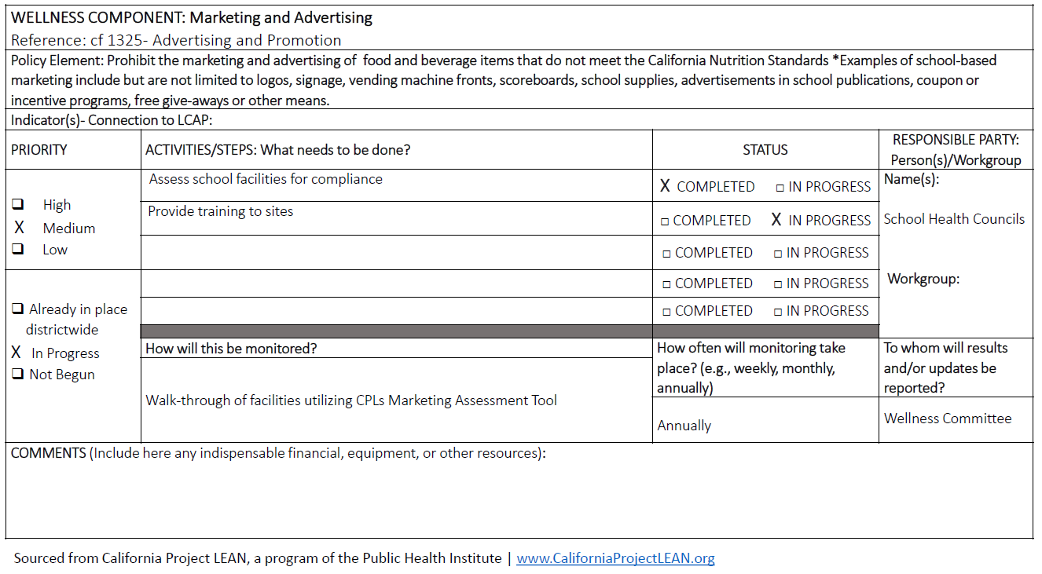
Triennial Assessment LSWP Compliance

Slide 25
Triennial Assessment Model LSWP Comparison
Alliance for a Healthier Generation Model LSWP
(https://www.healthiergeneration.org)
California School Boards Association LSWP Template
(https://www.csba.org)
Other options?

Slide 26
Triennial Assessment Progress Toward District Goals
Connects back to your goals
Gather information as necessary
Don’t bite off more than you can chew

Slide 27
Triennial Assessment Progress Toward District Goals
No set template
Resources are available!

Slide 28
Takeaway Ideas?
Think and share with your neighbor one “ah-ha” you learned today that you can take back to your district?

Slide 29
You are the ship…
…We are the tug boats…

Slide 30
Thank You!
Mike Danzik, MPH, RD
Nutrition Education Consultant
Nutrition Services Division
California Department of Education
mdanzik@cde.ca.gov
916-445-7346
This institution is an equal opportunity provider.

Slide 31
Professional Standards Credits
Key Area: Administration (3000)
Training Topic: Program Management (3200)
Learning Objective: Healthy School Environment (3230)
Total instruction time: 0.75 hours

