Slide 1
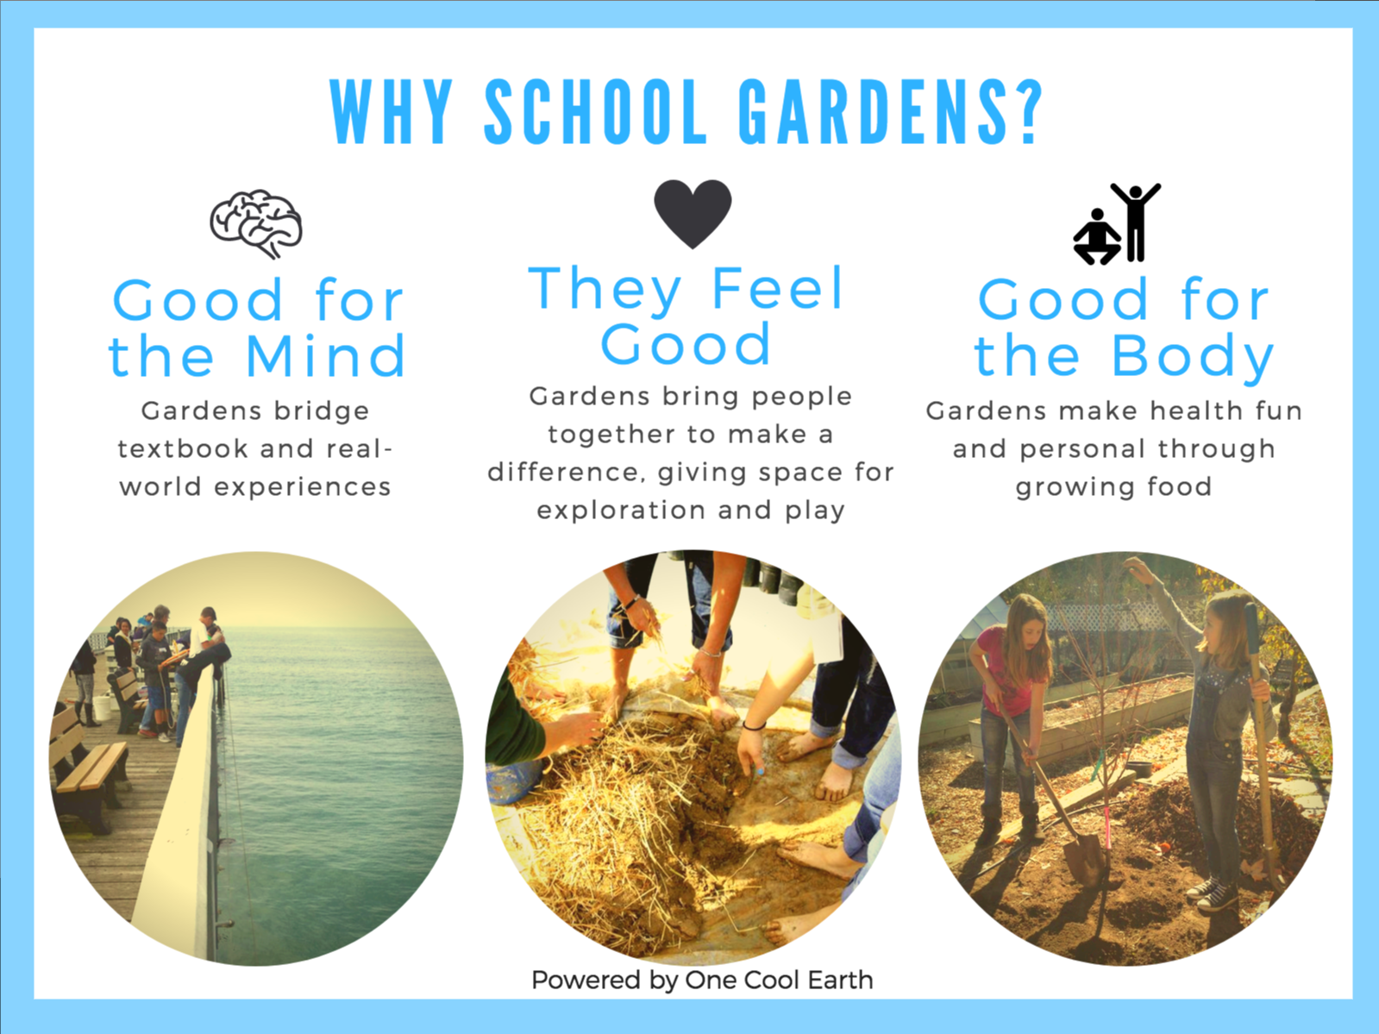
Notes:
Health (growing food), academics (standards-based lessons), happiness aka wellbeing (involving youth, beautiful & engaging spaces).

Slide 2
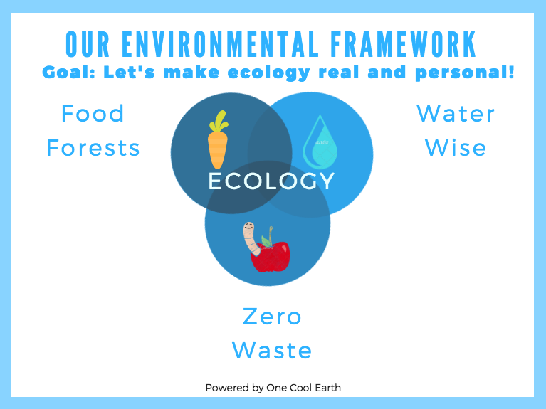
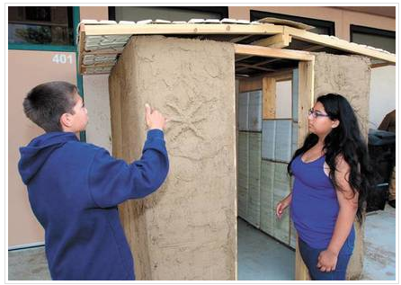

Slide 3
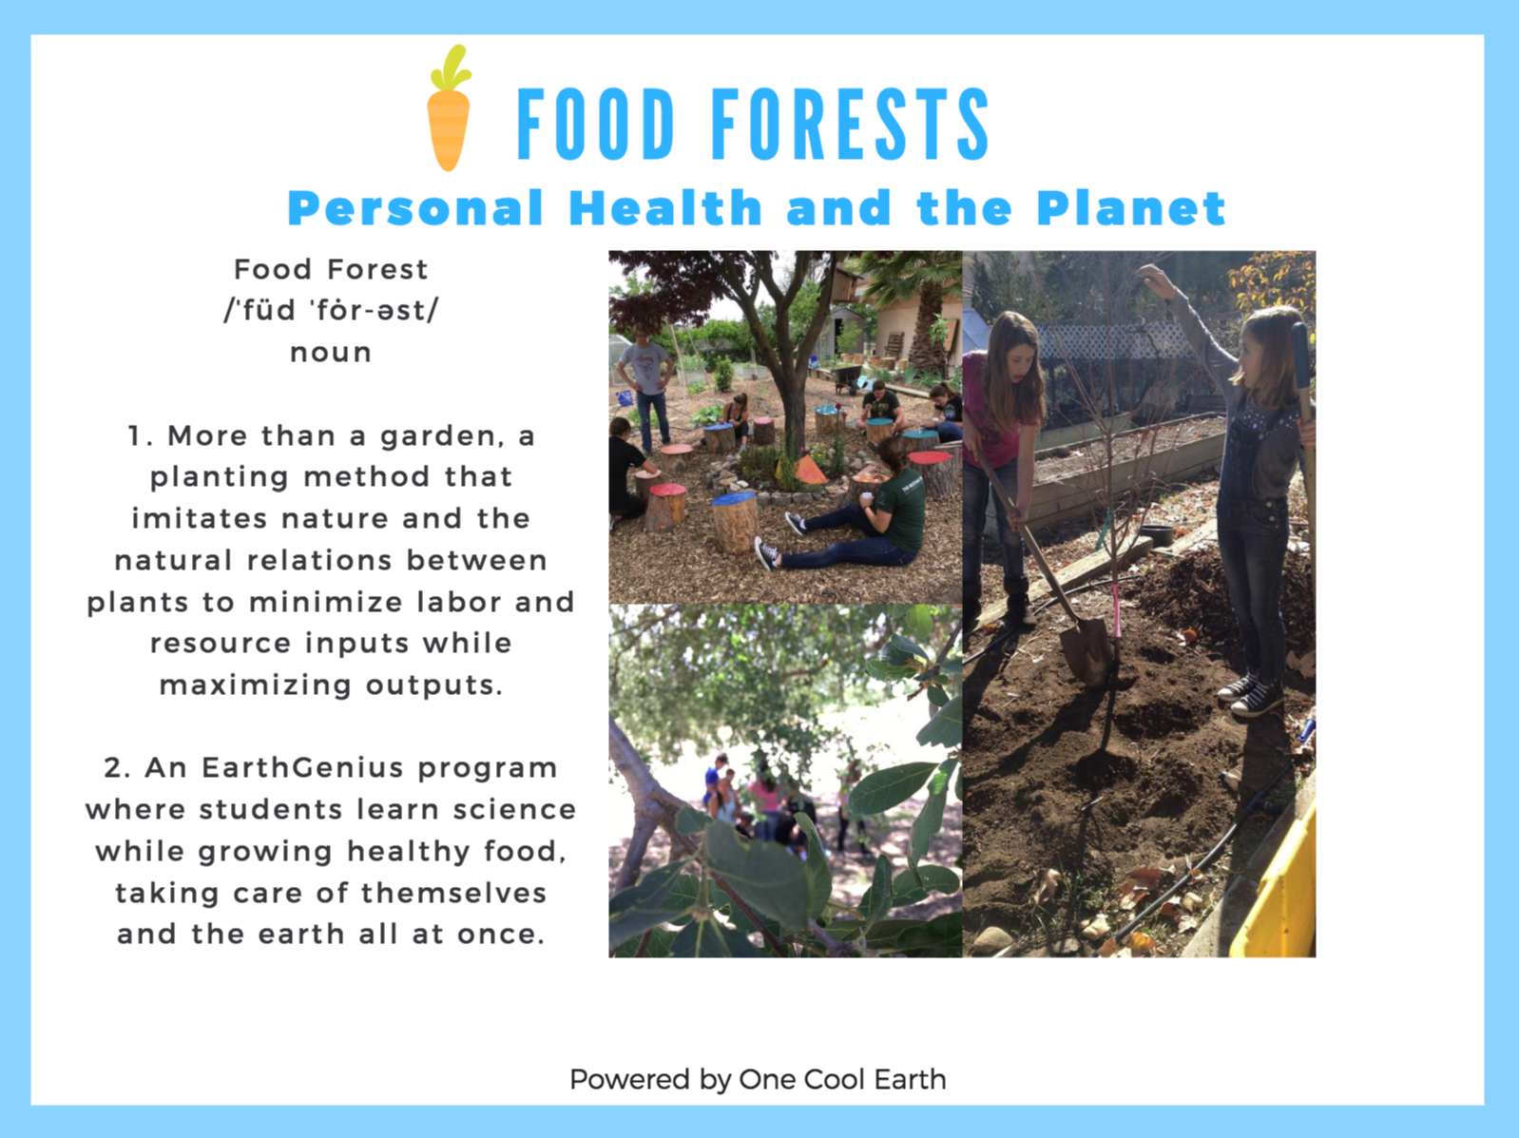

Slide 4
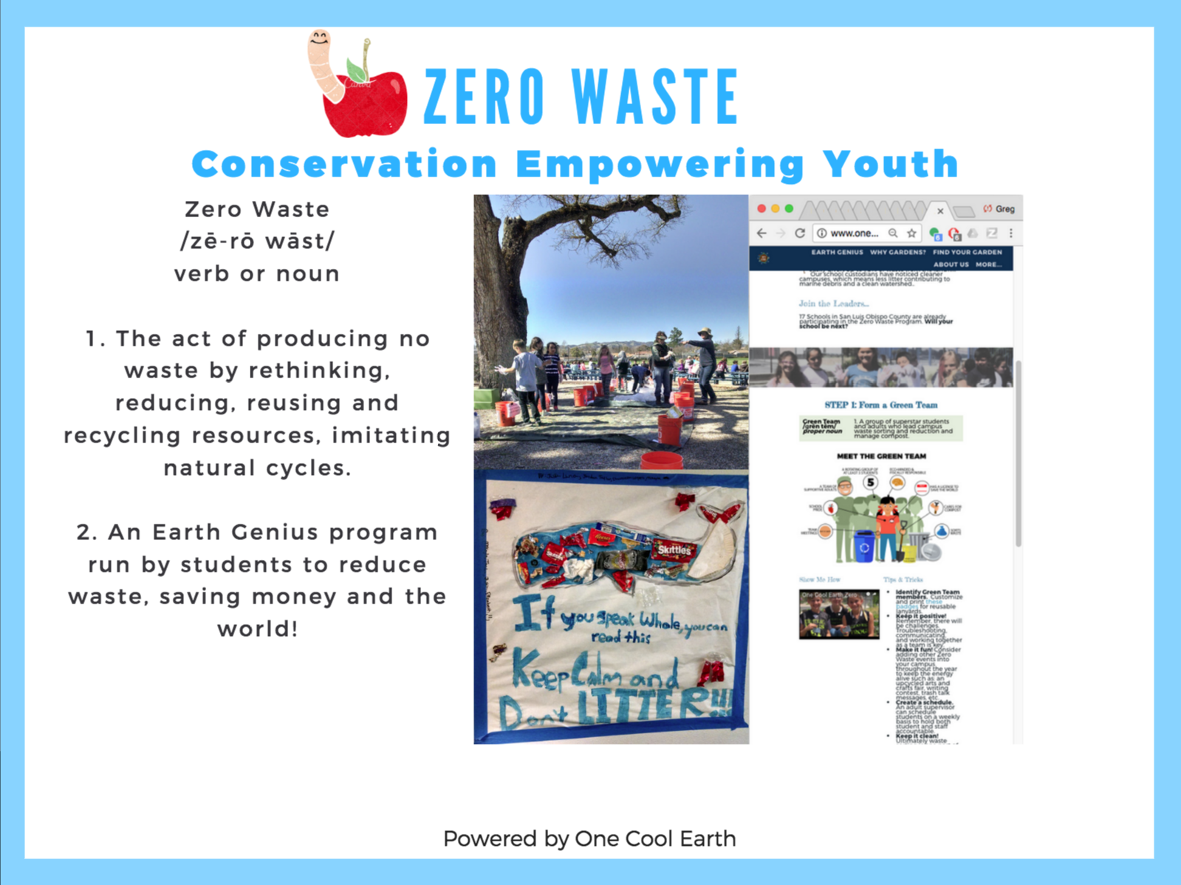
Notes:
More than 50% of waste generated at most school sites is divertable. We’d include anti-dumping message. We have website and many resources to make program sustainable.

Slide 5
Notes:
Great deal of uncertainty. Increasing development (Ag./Residential), increasing use, increasing costs. When one person saves, it benefits everyone. Lots of opportunities at schools: lawn conversion, rain barrels, infiltration. Empowers youth.

Slide 6
What can you take home?
Resource Orgs
www.onecoolearth.org
Master Gardeners
Explore Ecology
LifeLab
Cooperative Extension Office
Service groups (Rotary, Kiwanis)
Materials
Seedsavers Exchange
Botanical Interests
Farm Supply
HomeDepot
Simple garden plan
Zero Waste Info
Curriculum
earthgenius201819
Notes:
What is the purpose of your garden? Production, safe place, educational?

