Slide 1
Caring for Self and Others through the Seven Dimensions of Wellness
Erin Holohan—Director, Corporate Wellness Programs
10.30.2019

Slide 2
Goal
Evaluate your individual health and wellbeing with the same vigor you would use to evaluate your district, department or students.
Notes:
Gandhi – Be the change you wish to see in the world
If you want to change the world, start with yourself

Slide 3
Make sure to apply your oxygen mask first

Slide 4
You cannot pour from an empty cup

Slide 5
Part One
Part Two
Caring for Self – an interactive action planning program to evaluate seven areas of life that directly impact your quality of life.
Caring for Others – using Part One as a framework to share with others and leverage best practices to promote good health and well-being.
Notes:
Explore how you can elevate your well-being, and your co-workers and students well-being, igniting an environment that fosters achievement of full potential

Slide 6
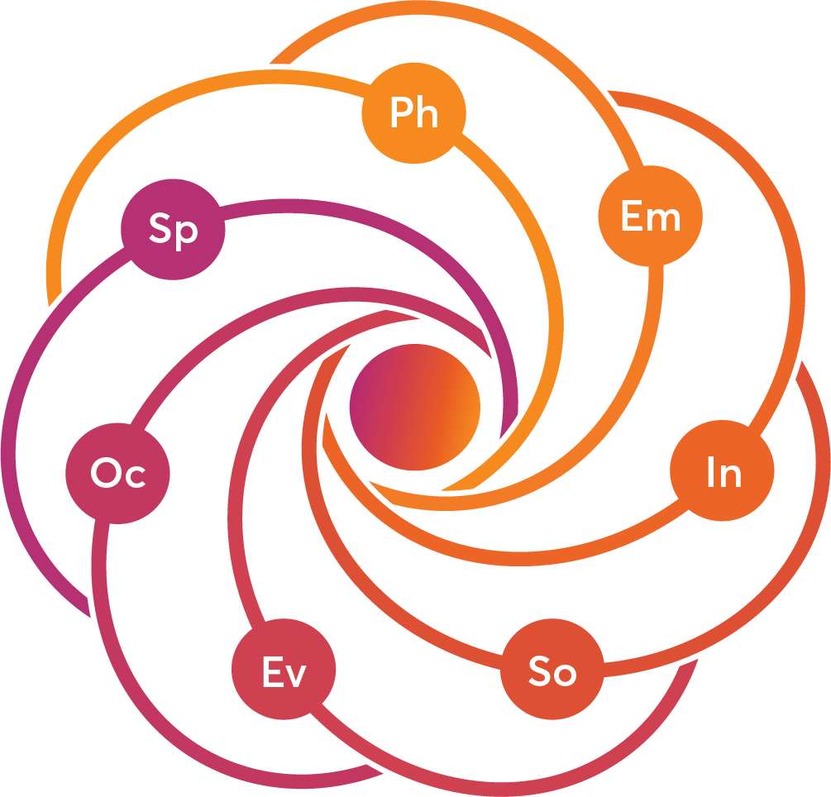
Part One: Leading Self

Slide 7
Let’s think through two questions:
What do I value most?
How satisfied am I?
Notes:
What do you think might come from addressing these questions – not just for you but for your family, your work teams, your school?

Slide 8
The Seven Dimensions of Wellness
Physical
Emotional
A body that works
Ability to cope
Spiritual
Intellectual
Purpose and meaning
Expanding our mind
Occupational
Social
Work that fulfills us
Connecting with others
Environmental
Harmony with our surroundings

Slide 9
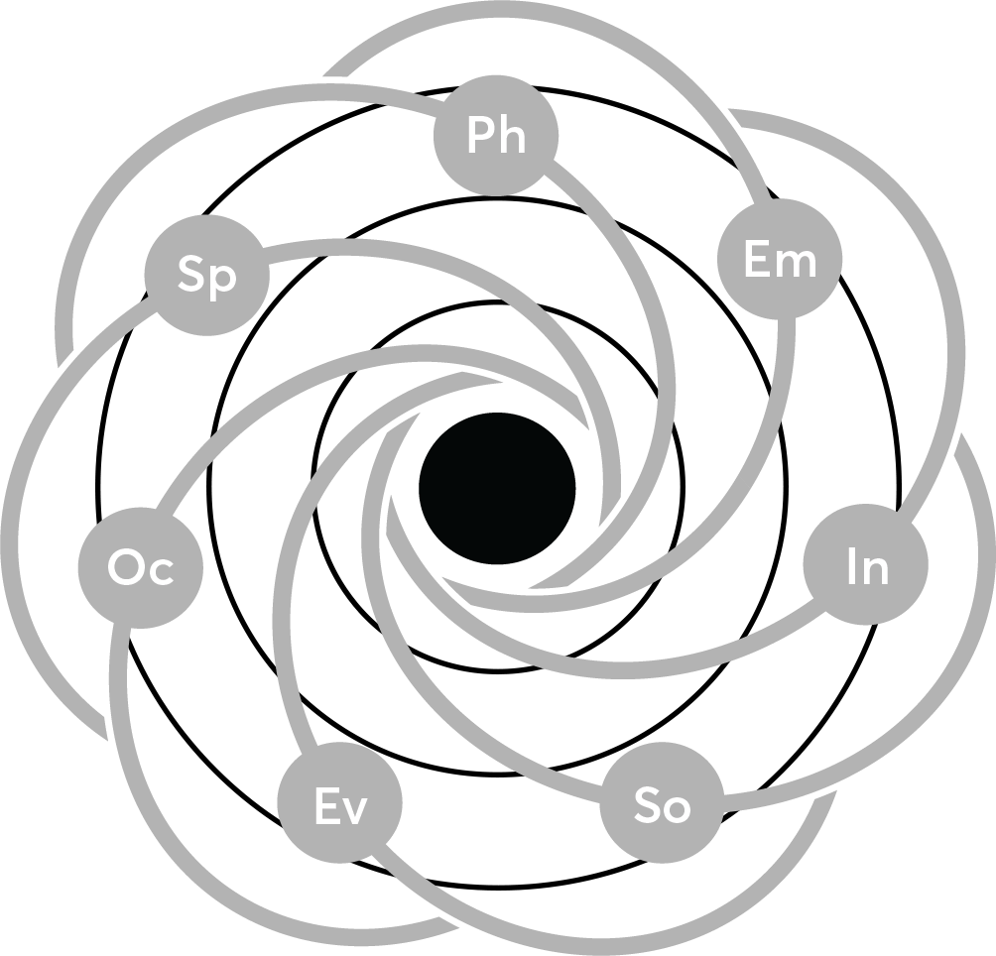
4
V
3
2
V
1
V
V
V
V
V
Notes:
Here we've shown the seven dimensions of the wellness atom. I want you to first ask yourself which of these areas are most important to you – on a scale of 1-4, how much do you value that dimension of wellness. Use a "V" to plot your current level. When you’ve done that, circle the three areas that are your highest values. This first part of the exercise will show you what you value most. Once you know that, you can begin to understand your purpose—what drives you and the guides your choices.
Then rank your current level of satisfaction by coloring in each of the dimensions (scale of 1-4). Now, let's get a "gut feeling" sense of how satisfied your are in these areas. This information will help you set realistic goals for achievement and improvement.
Don't think it over too much; go with your first response. Fill in at the level that best represents the satisfaction you feel in this dimension.

Slide 10
Building a Wellness Committee
Steps to Getting Started
Assessing Needs and Interests
Determining Goals & Objectives
Creating an Annual Plan

