Slide 1
Engaging youth in nutrition and physical activity promotion:
CalFresh Healthy Living, UC
Presented by
Melissa Rorabough
Community Education Specialist II

Slide 2
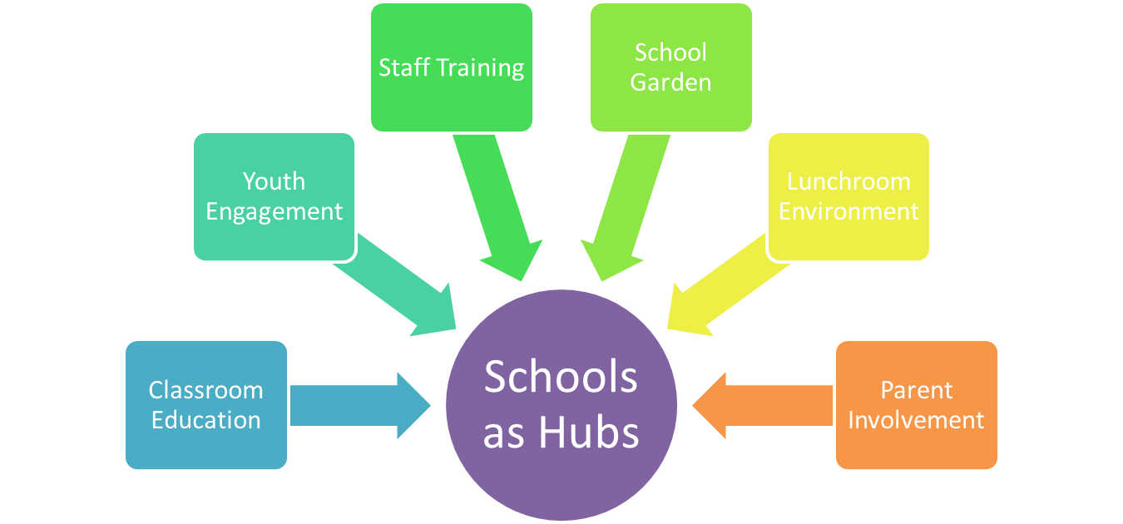
What is CalFresh Healthy Living, UC and what do we do?
Notes:
Why we have it and where did it come: what is calfresh healthy living how does snac fit in Where does catch fit in

Slide 3
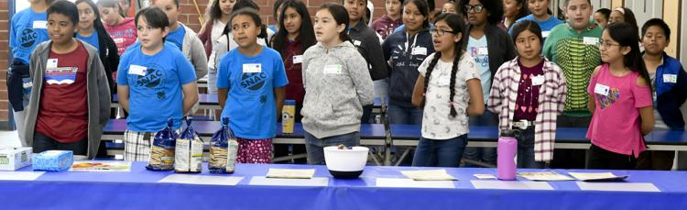
What is 4-H SNAC?
A collaboration between CalFresh Healthy Living University of California branch, 4-H youth development, and Santa Maria Bonita and Lucia Mar School Districts.
An afterschool program at 5 schools
A student led group to promote health and wellness
Notes:
Why we have it and where did it come: what is calfresh healthy living how does snac fit in Where does catch fit in

Slide 4
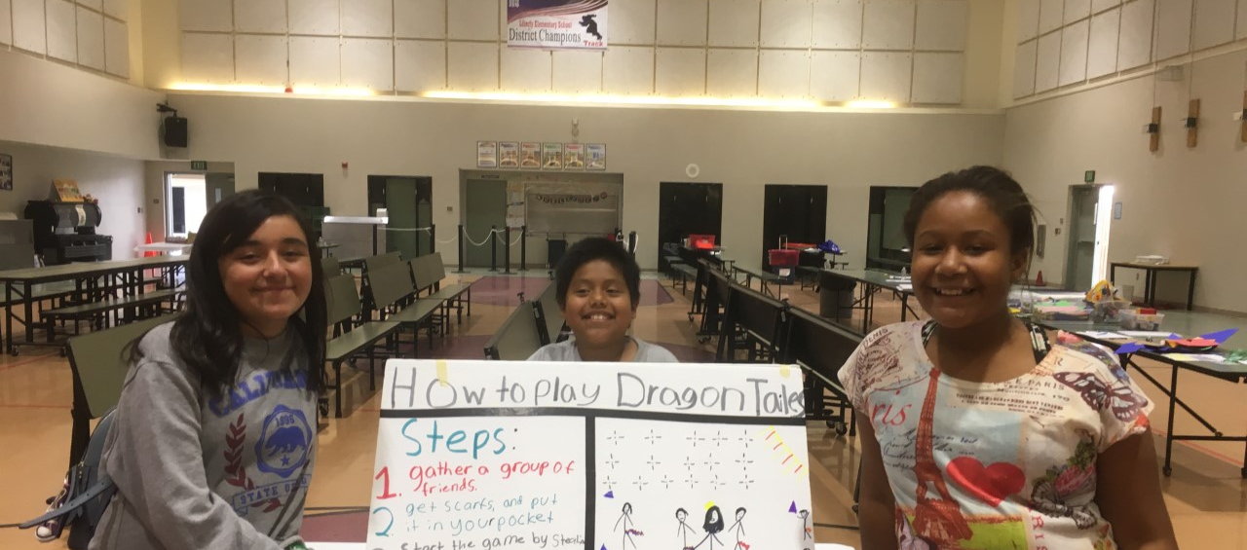
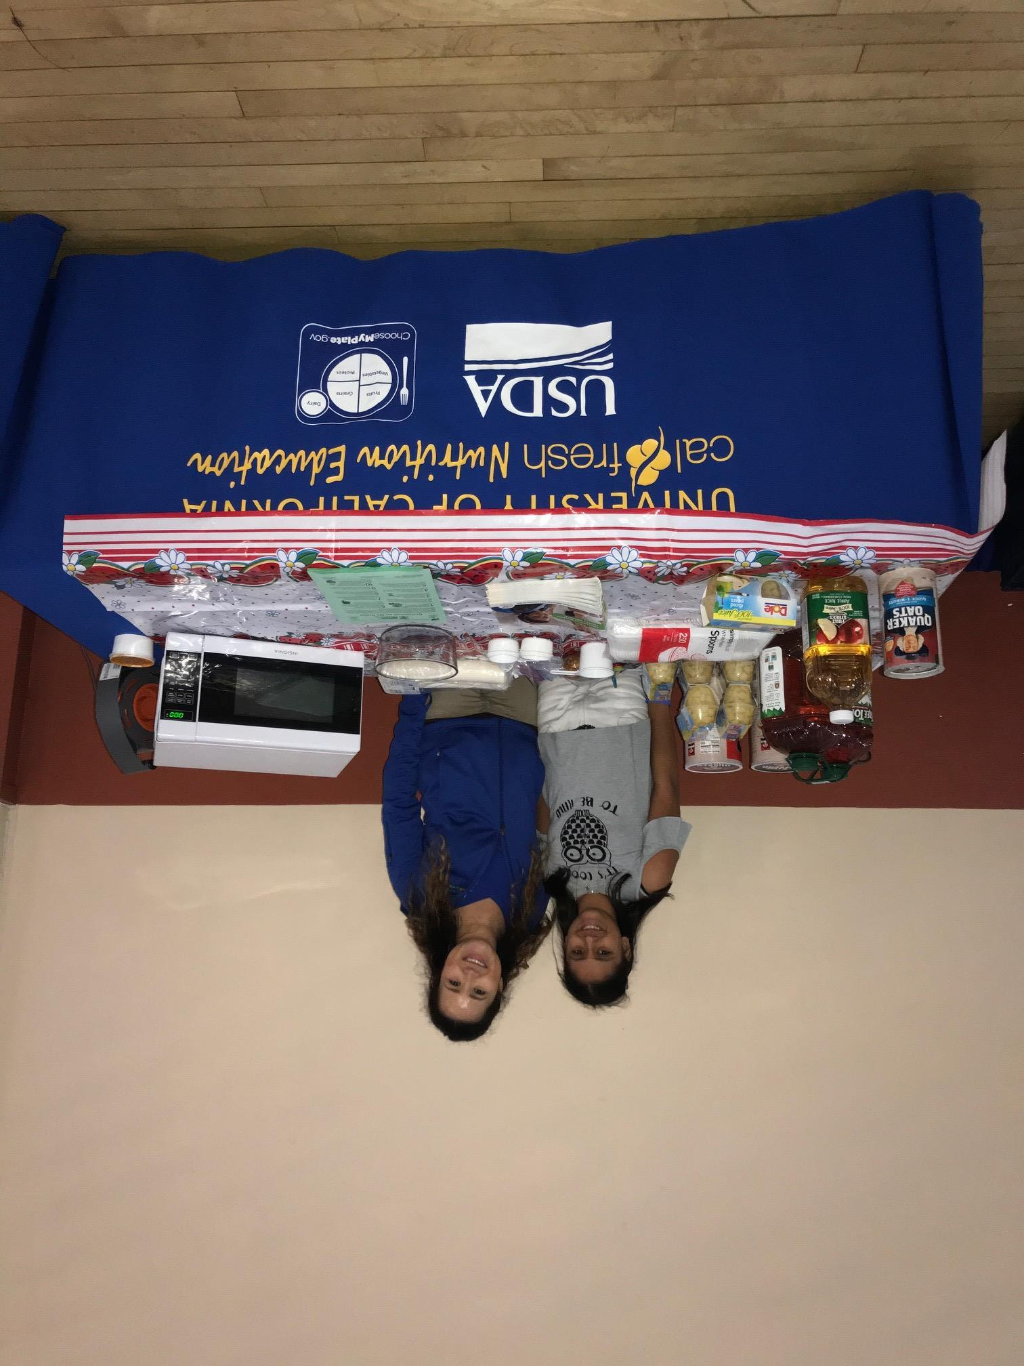
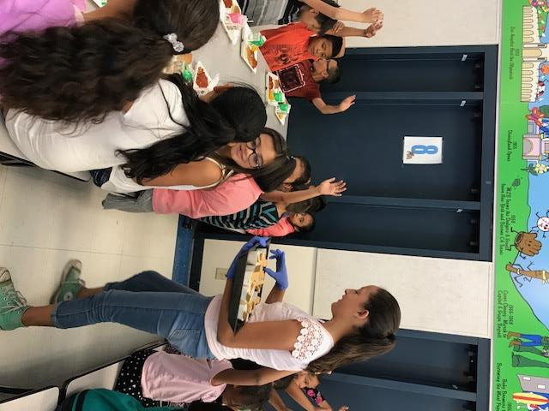
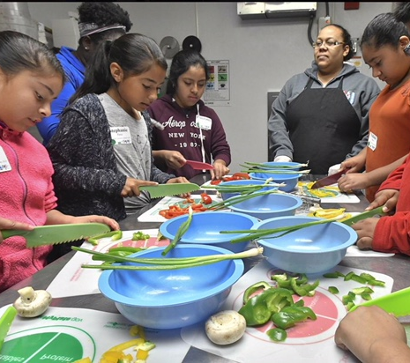
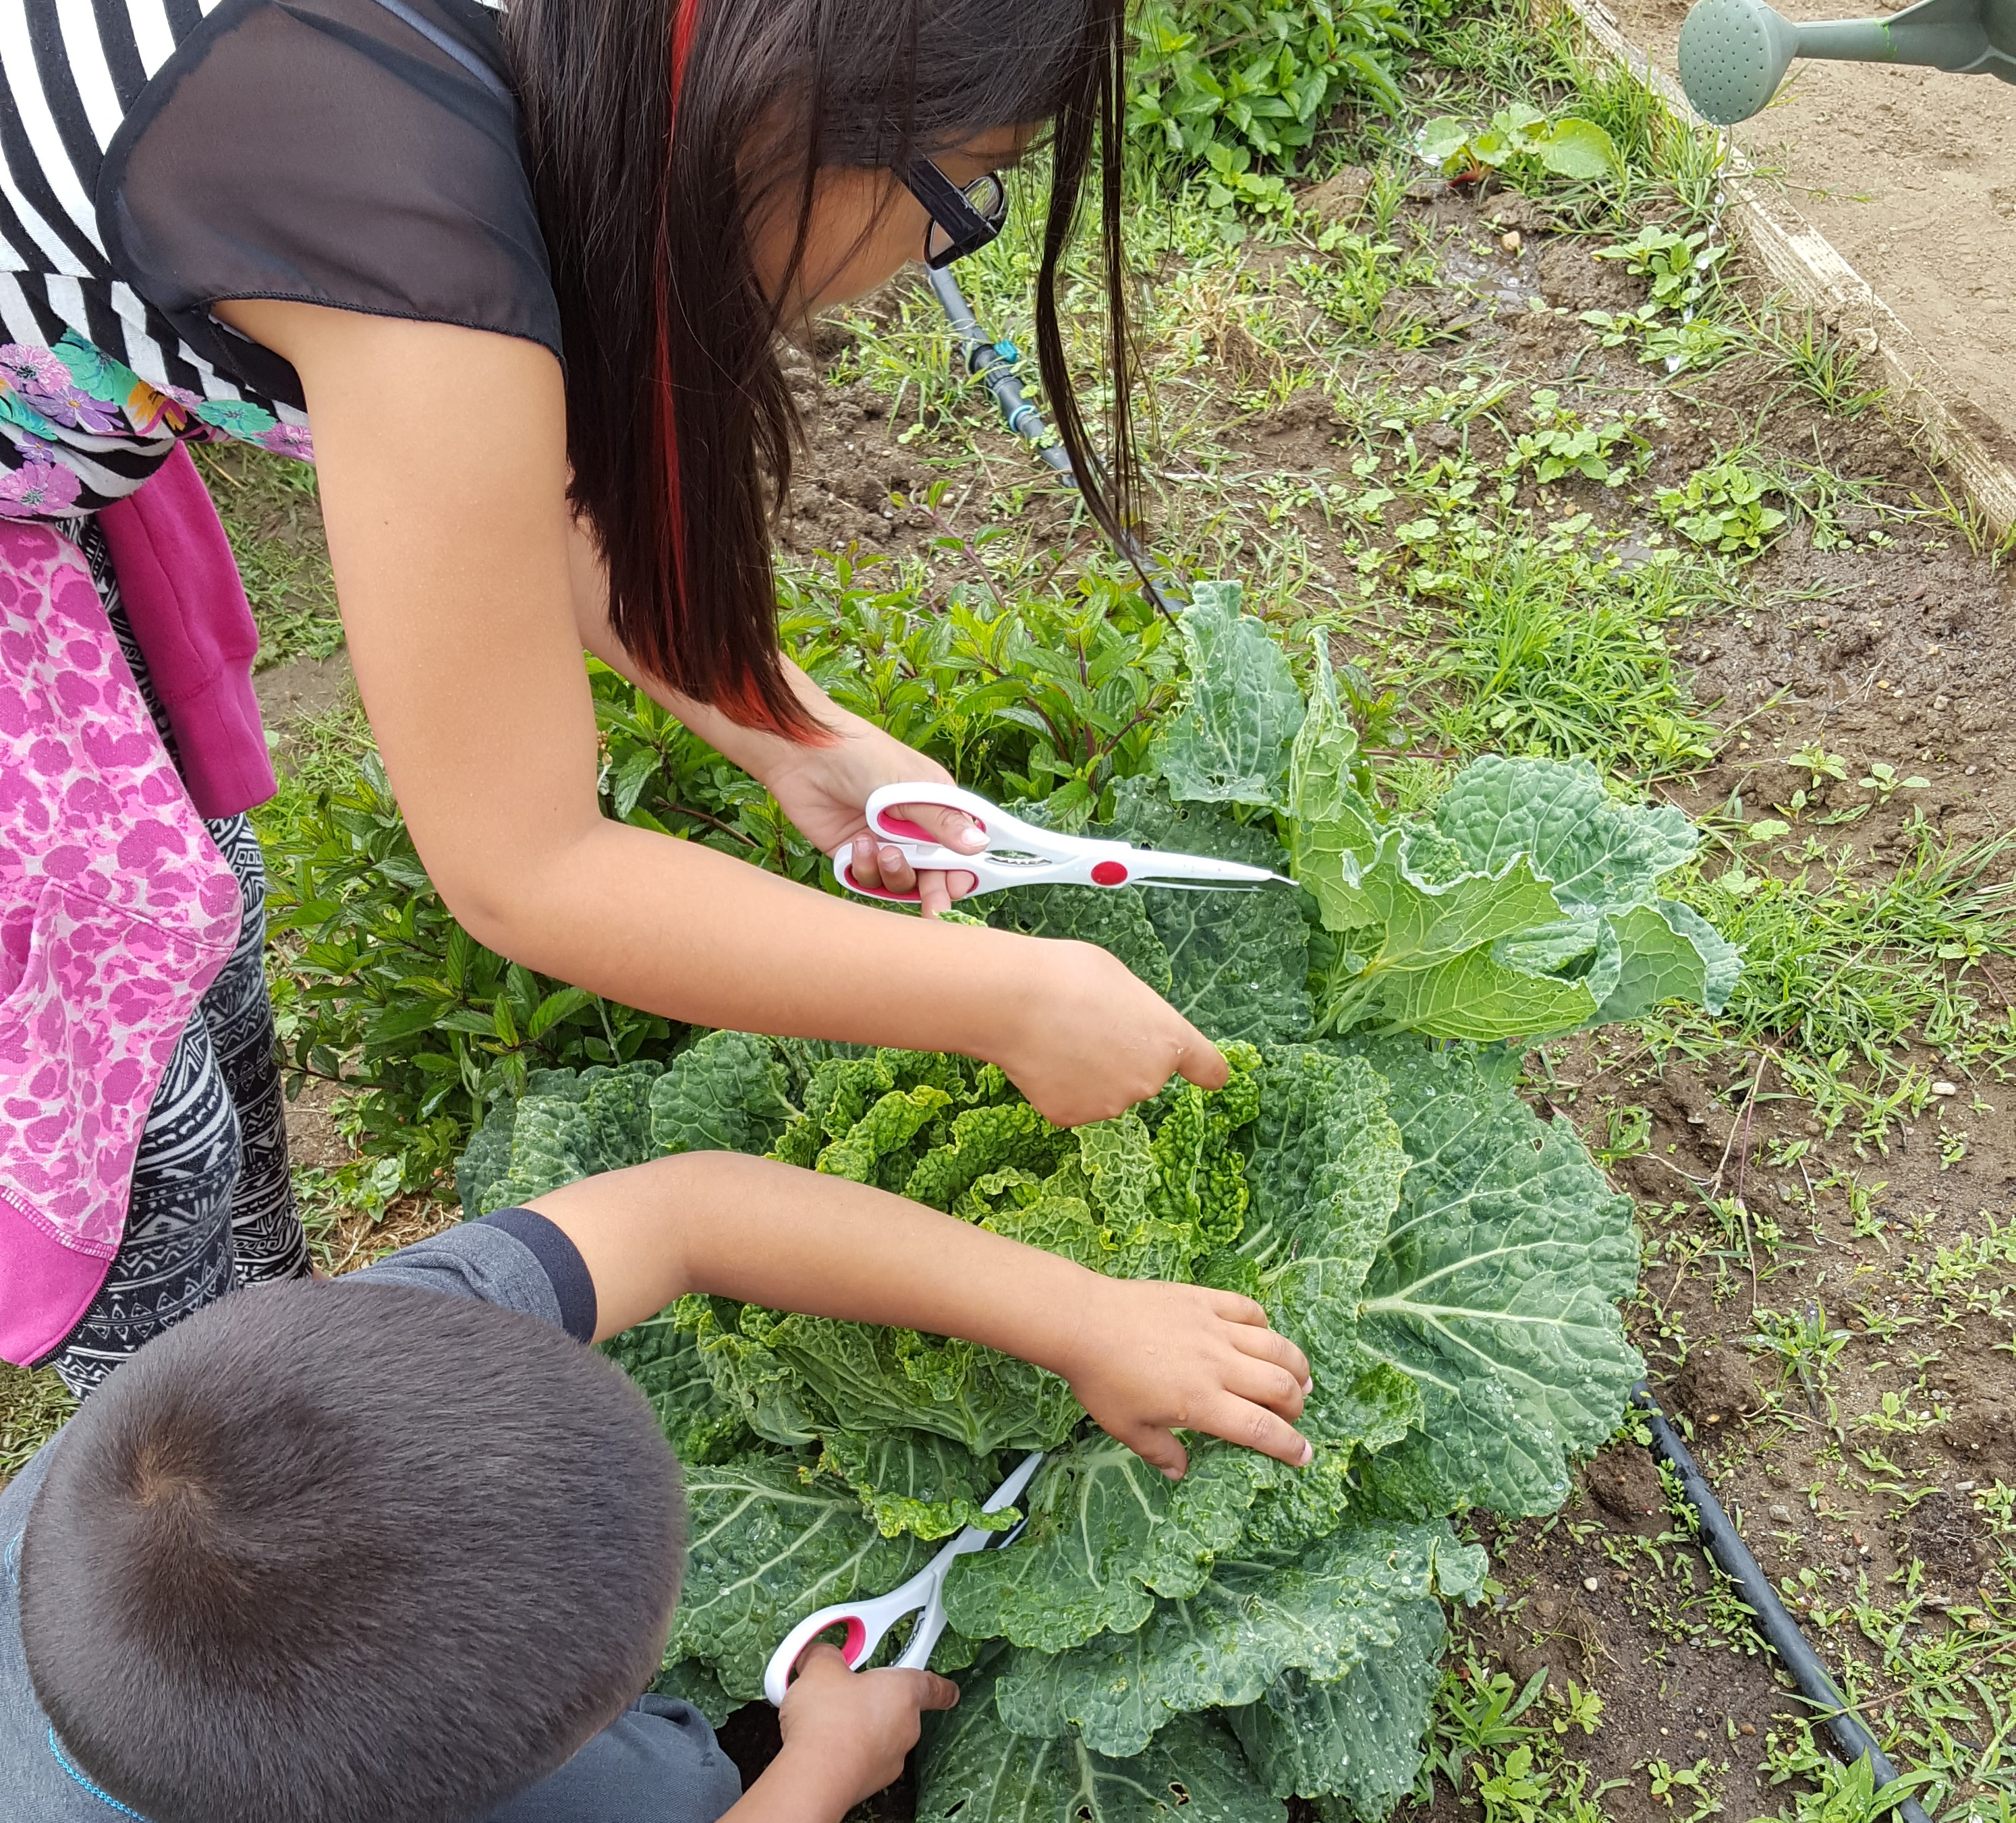
What do students learn?
Health and Nutrition
Cooking techniques
Leadership
Teaching skills
Physical activity
Gardening

Slide 5

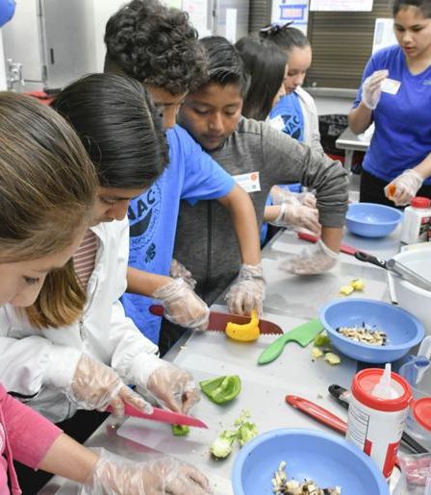
Trainings for 4-H SNAC Members
Leadership Training
Learn presentation skills
Participate in career fair
Present to parents and adults
Culinary Academy
Cooking skills: knife skills, baking and stove top
History of food items and countries
Food safety

Slide 6
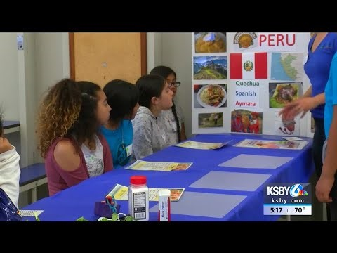

Slide 7

Notes:
Importance of movement stats

Slide 8
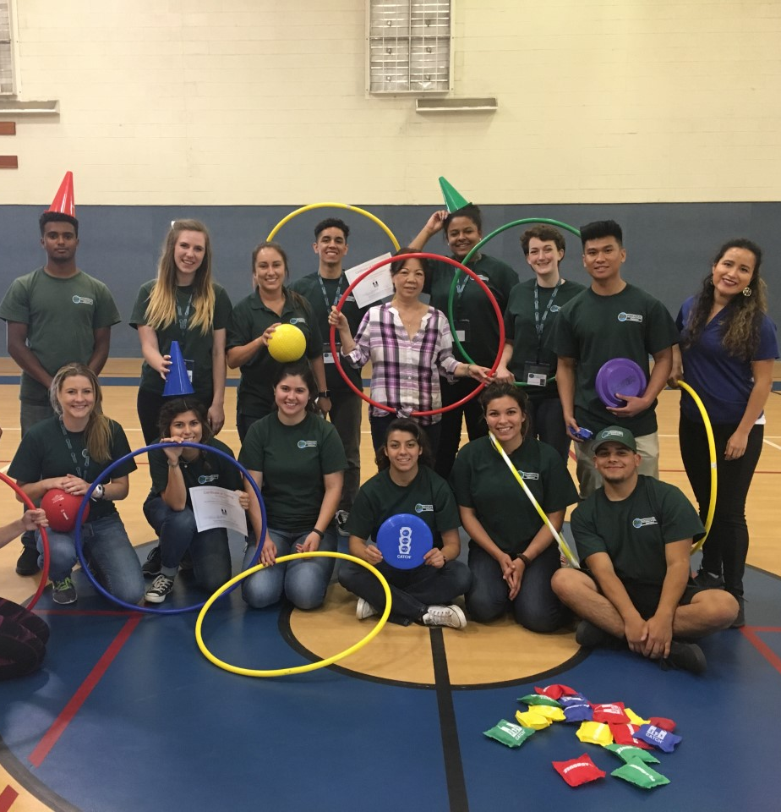
What is CATCH P.E.?
Notes:
CATCH stands for a Coordinated Approach To Child Health, and is scientifically proven to be a highly effective health, physical activity, and nutrition education program for children from all backgrounds. The CATCH platform has enabled thousands of schools, families and communities to create an environment that improves children's health, increases academic success, and supports a lifetime of wellness.

Slide 9
CATCH Objectives:
Students enjoy physical activity
Students are involved in MVPA for 50% of class time
All students are provided with many opportunities to participate & practice skills
Students are encouraged to participate in physical activity outside of PE class

Slide 10
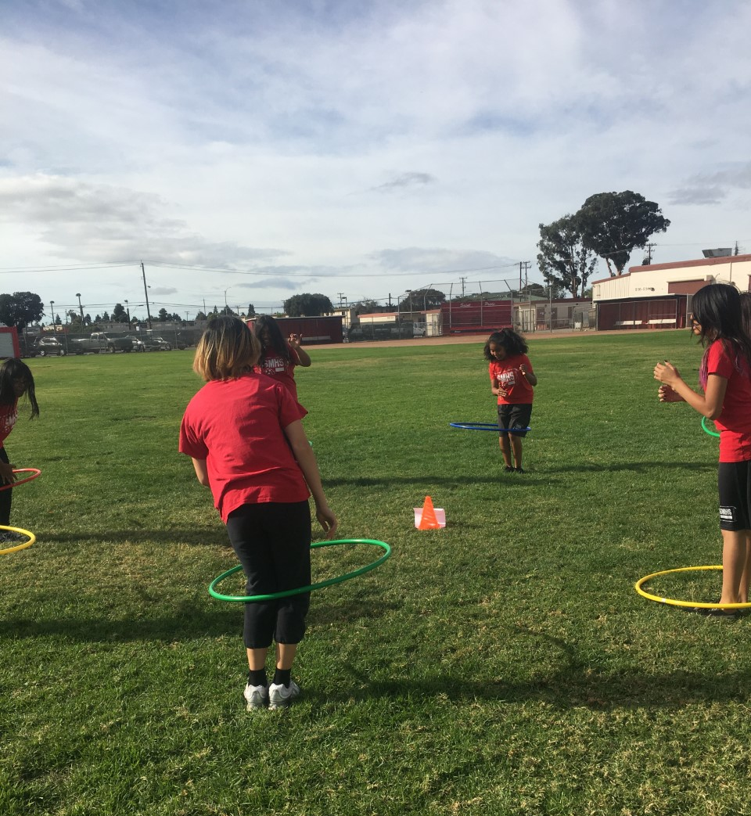
Ways to engage youth in teaching CATCH
High school students can teach elementary school
4-H SNAC students teaching peers

Slide 11
How Can You Implement CATCH?
Free online resources including sample lessons and activities at CATCH.ORG
Talk to your PE specialist- CATCH is the adopted PE curriculum for Santa Maria Bonita School District

Slide 12
Thank you!
Melissa Rorabough mslafreniere@ucanr.edu
(805)781-5947

