Slide 1
THE INTERSECTION OF HEAL, WORKPLACE WELLNESS AND POLICY
Blythe Young
Policy Specialist
PHAdvocates

Slide 2
Learning Objectives
▪ The role of policy in a successful workplace wellness program.
▪ Policy Areas targeted to support healthy workplace environments and practices.
▪ Examples of successful policy implementation.

Slide 3
HEAL Model for Workplace Wellness:
Cities can reduce the impact of stress and poor health on their employees by creating a work environment and programs, that support nutrition, physical activity, breastfeeding and stress reduction. A healthier workplace can contribute to increased morale, fewer sick days and higher productivity.
Notes:
My name is Blythe Young and I am a Policy Specialist at Public Health Advocates. At Public Health Advocates we work to promote health and eliminate health disparities by transforming neighborhoods into places that nurture well-being. The HEAL Cities Campaign is one of our initiatives. Through the HEAL Campaign -- HEAL stands for Healthy Eating and Active Living – we provide online resources, training, and technical assistance to local elected officials and municipal staff in California to adopt policies and practices that promote access to healthy, affordable foods, active living, and a healthy municipal workplace.
The HEAL Campaign is funded by Kaiser Permanente, our founding partner.

Slide 4
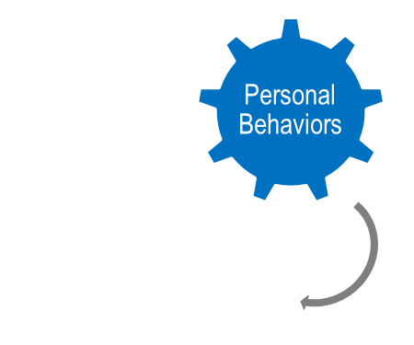
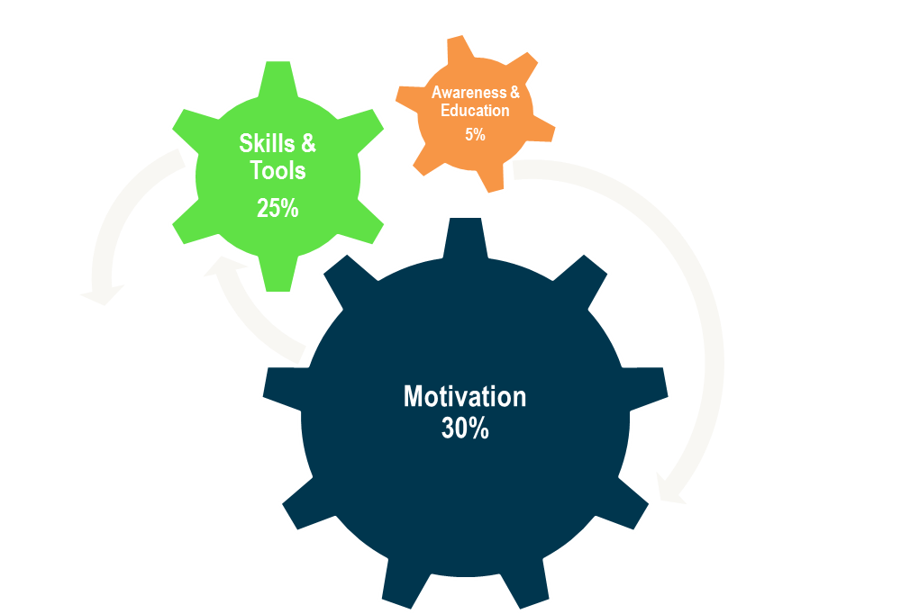
The Importance of Policy

Slide 5
What do we mean by policy?
A policy is:
Policies take many forms:
a statement in writing
binding
setting out a general approach to be applied broadly
Guidelines
Standards
Resolutions
School/agency policy language
Organization/company policies
Contracts/agreements
Local ordinances
Zoning language

Slide 6
PLEDGE the Practice PASS the Policy
Practices
▪ You can start today
▪ You can take action on your own
▪ No additional resources necessary to implement
Programs
▪ May take some time to plan
▪ May require support and assistance to implement
▪ May require additional resources (time, money, space)
Policies
▪ Will take a longer period of time to implement
▪ Will require leadership buy-in
▪ Will require ongoing education and support
▪ Offers greater sustainability

Slide 7
HEAL Model for Workplace Wellness Policy:
▪ Gain leadership support
▪ Establish a workplace wellness committee with interdepartmental support
▪ Use data to inform policy and programs
▪ Keep it simple – make the healthy choice the easy choice
▪ Pass an employee wellness resolution for your policies and programs
▪ Stay engaged!
Notes:
My name is Blythe Young and I am a Policy Specialist at Public Health Advocates. At Public Health Advocates we work to promote health and eliminate health disparities by transforming neighborhoods into places that nurture well-being. The HEAL Cities Campaign is one of our initiatives. Through the HEAL Campaign -- HEAL stands for Healthy Eating and Active Living – we provide online resources, training, and technical assistance to local elected officials and municipal staff in California to adopt policies and practices that promote access to healthy, affordable foods, active living, and a healthy municipal workplace.
The HEAL Campaign is funded by Kaiser Permanente, our founding partner.

Slide 8
What policies should you consider?
Wellness
Physical Activity
Nutrition Standards
Mental Wellness
Healthy Meetings
Stretch Breaks
Breastfeeding and Lactation

Slide 9
Policy Examples
Low Cost/ No Cost Policies:
Investment Policies:
Healthy Vending
Active Transportation
Physical Activity Incentive/Stipend
Lactation Accommodation
Active Stairwell Policies
Stretch Warm-Up Policy
Healthy Meetings Policies
Nutrition Guidelines
Walking Meetings
Flexible Work Schedules
Structured Activity Breaks

Slide 10
Stretch Breaks
The San Francisco Public Works Department maintains an award-winning program of stretching for general services employees at their worksites each morning.

Slide 11
Healthy Meetings
Public Health Advocates and many other organizations and cities have passed policies or guidelines for Healthy Meetings.

Slide 12
Mental Wellness and Stress Reduction
The City of Thousand Oaks partners with local health care providers to offer free lunchtime classes and campaigns on specific health topics such as mental wellness and stress reduction.

Slide 13
Flexible Work Schedules for Work/Life Balance
The City of Berkeley passed a Berkeley Family Friendly and Environment Friendly Workplace Ordinance to give employees the right to request part-time work, flexible hours and flexible working arrangements.

Slide 14
Active Stairwells
The City of Chino set standards for stairwell safety – including unlocked doors into stairwells and adequate lighting – and encourage employees to use stairwells whenever possible.

Slide 15
Active Transport
The Town of Windsor adopted a policy to support a bike sharing program for employee use.

Slide 16
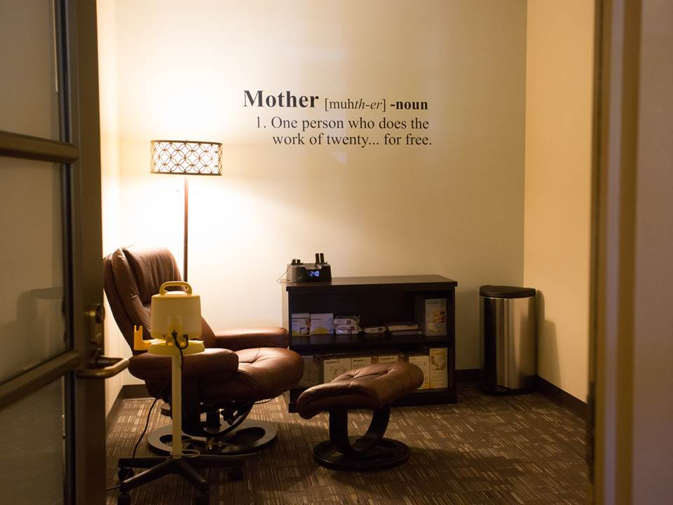
Lactation Accommodation
The City of Rancho Cucamonga established a set of policies to support breastfeeding and lactation accommodation to all employees.

Slide 17
What change will you make?

Slide 18
BLYTHE YOUNG
POLICY SPECIALIST
BY@PHAdvocates.org
707.834.4399

