Slide 1
PARKS
as Community Systems

Slide 2
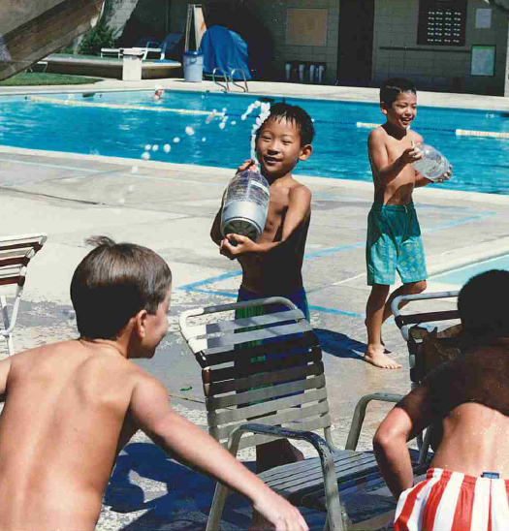
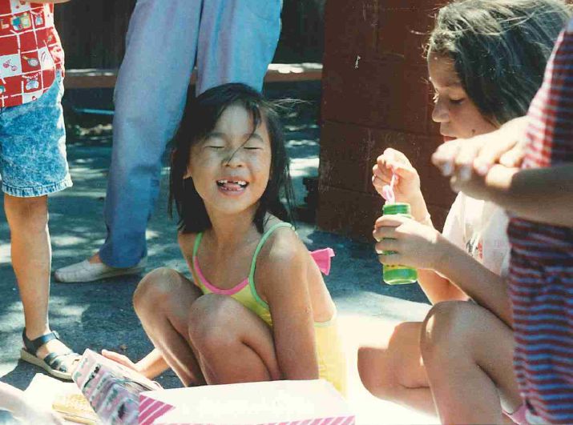
Benita Turns 7!
Greenmeadow Park & Pool
© Benita Tsao
© Benita Tsao

Slide 3
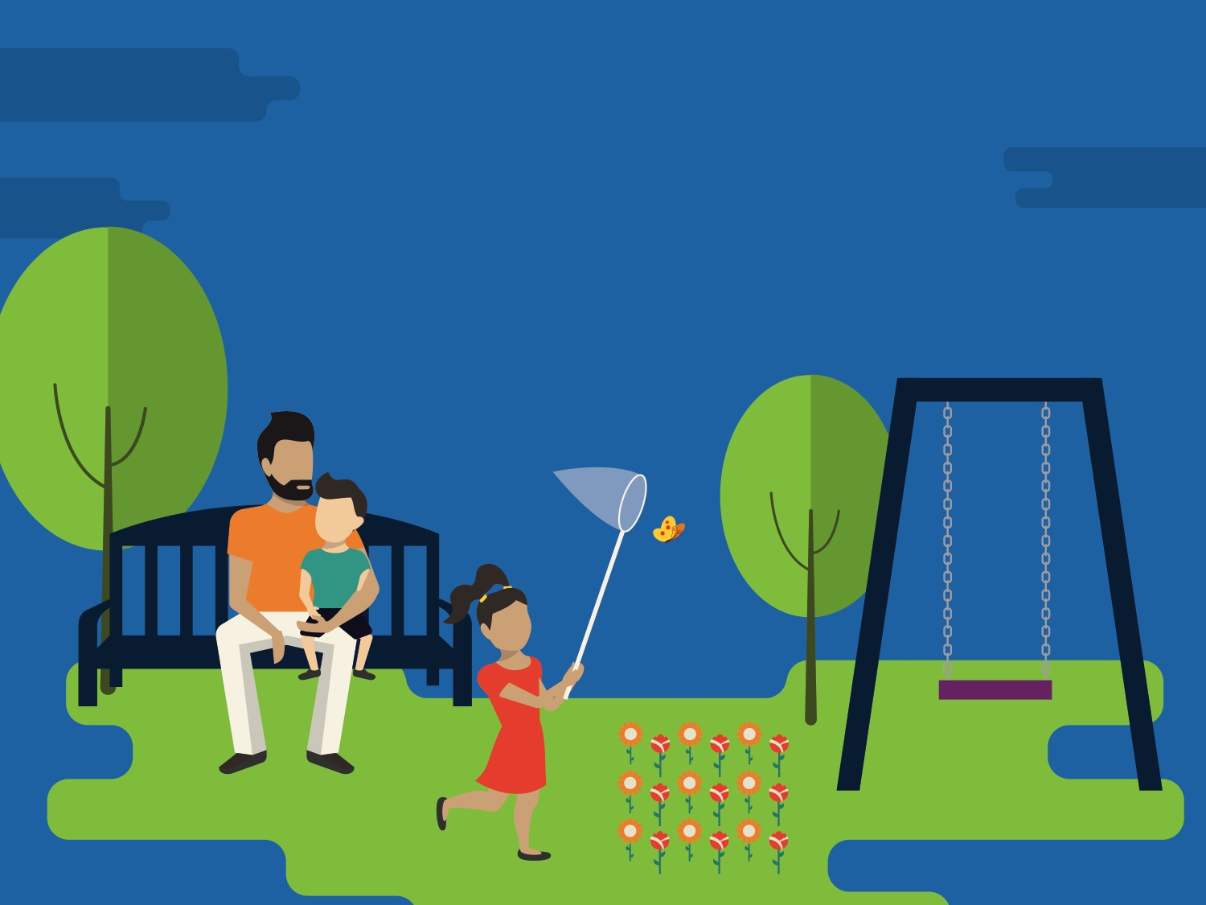
Parks & Recreation
Notes:
Policies can create healthy, safe parks in our neighborhoods. Ensuring new developments provide green space. And existing parks are well-maintained. Which help us stay physically active and connect with our neighbors.

Slide 4
Complete Parks

Slide 5
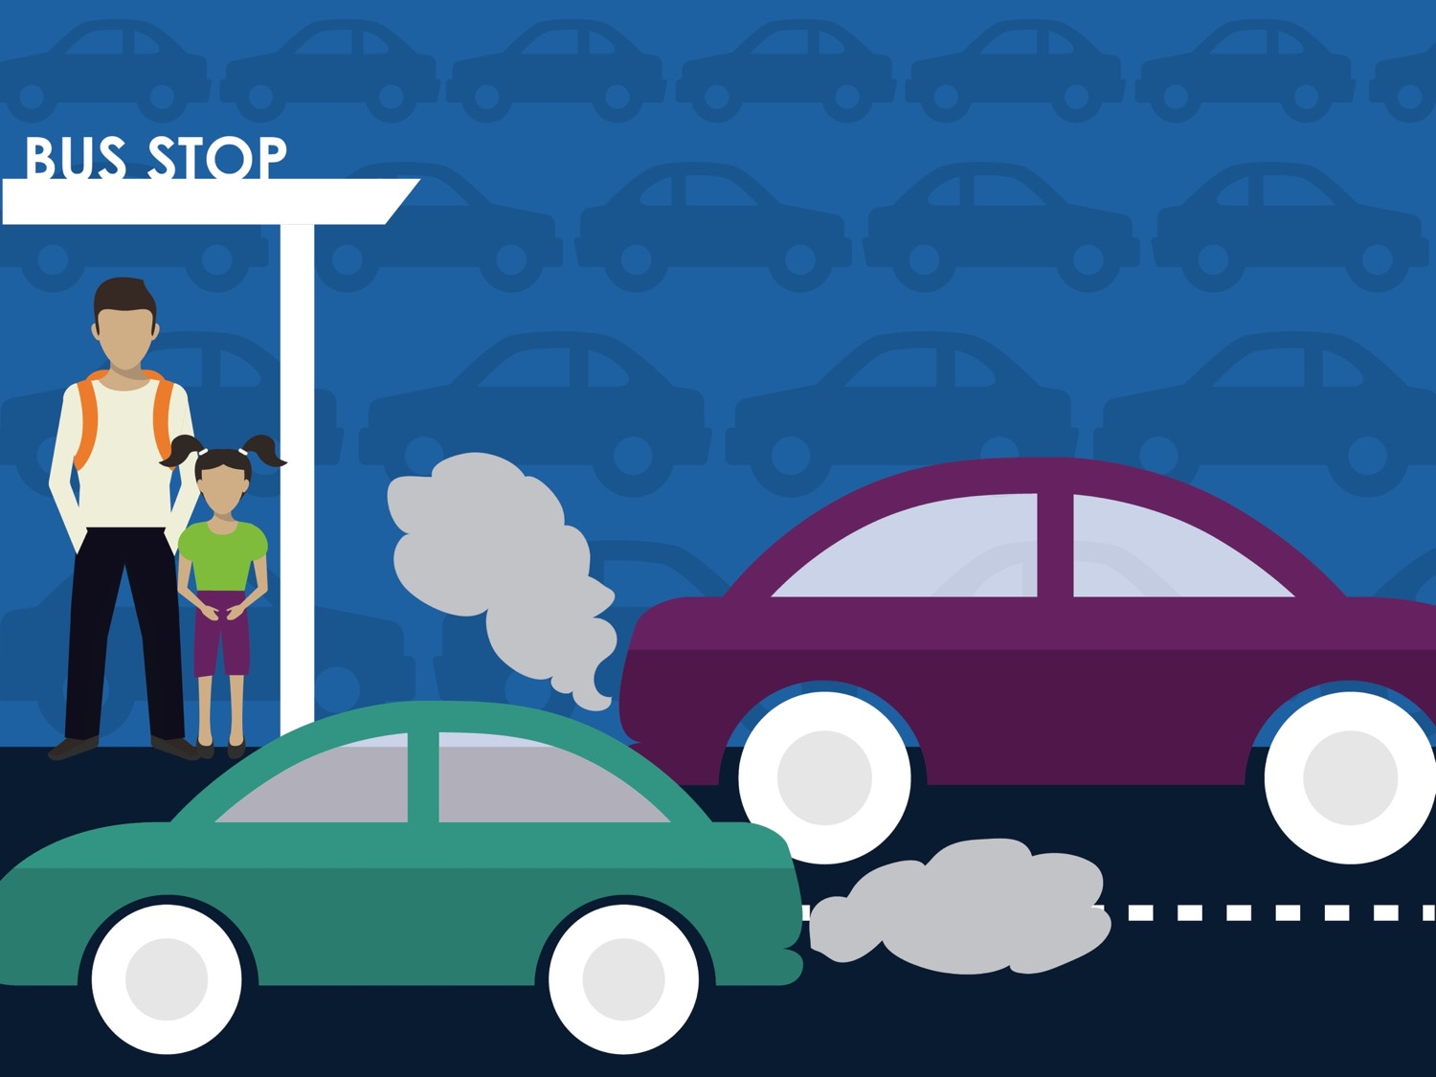
How will people get there?
Notes:
Without talking to their local air quality agency about how more cars on the road…Increases air pollution and makes asthma symptoms worse. Or, the transportation department might never talk to their local health department about how designing streets that encourage more people to get out of their cars to walk, bike, or take transit. Means residents will be healthier and reduce time spent in traffic. Because transportation policies weren’t connected to policies for clean air and physical activity, we missed the opportunity to reduce congestion while achieving better health

Slide 6
Do people feel safe there?
Notes:
Policies make it possible for communities to be safe and violence-free. By requiring lighting at bus stops or in parks. And requiring builds to have windows that face out onto the street, which makes it possible for people to safely walk to the bus stop at night.

Slide 7
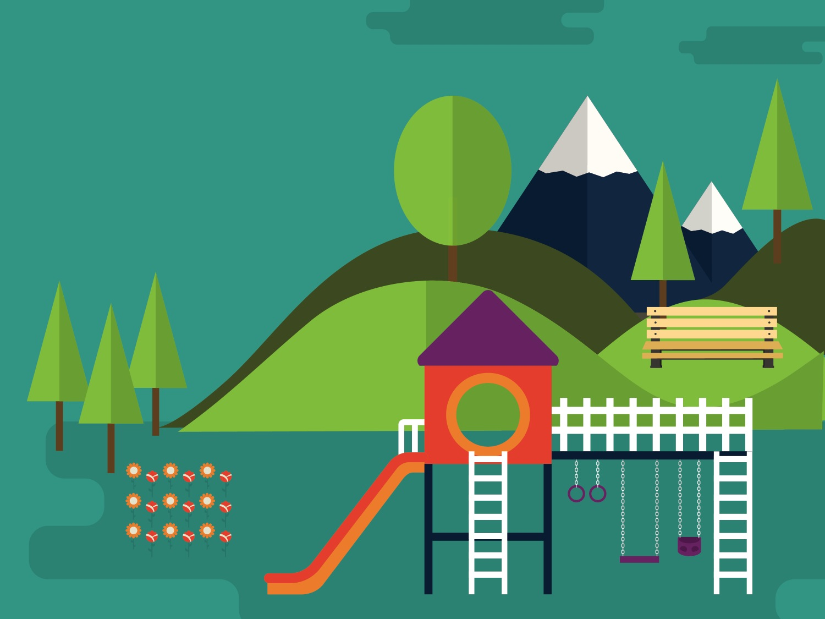
Who is welcome? Who is left out ?
Notes:
For example, a parks and recreation department might invest in a new park

Slide 8
Collaboration across local government agencies

Slide 9
Meaningful, ongoing
community engagement

Slide 10
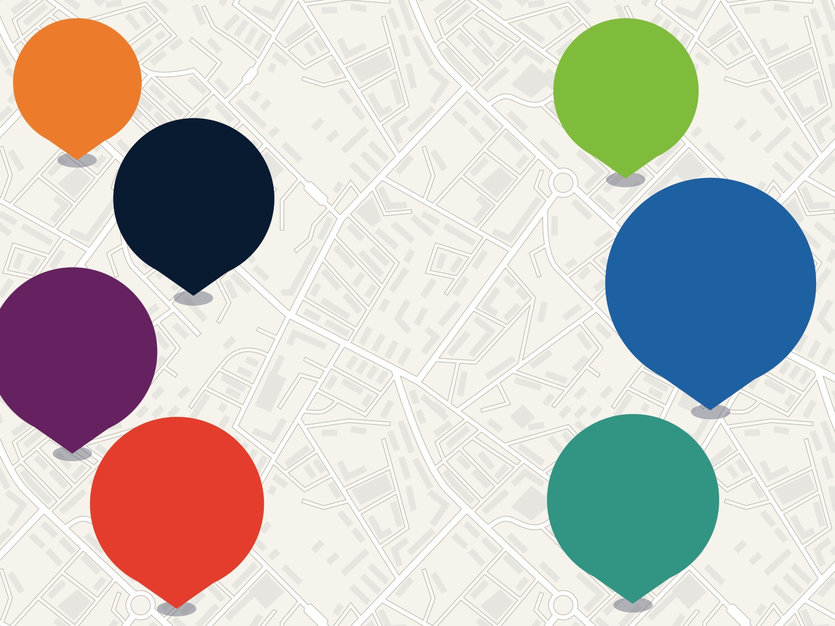
Locate
Grow
Connect
Engage
Complete Parks
Activate
7 ELEMENTS
Fund
Protect
Notes:
You may have also heard of Collective Impact, which identifies five conditions for successful partnership. Health in All Policies can help you develop strong partnerships because it checks off all these boxes and has a track record of success:
A common agenda among partners from various sectors (in HiAP, this is health, equity, and sustainability)
A shared measurement system, an agreement on what success looks like and how to track progress
Mutually-reinforcing activities, coordinated and complementary efforts
Continuous communication among partners—you’ll see that convene and collaborate is Step 1 of Health in All Policies and that these relationships drive the process and the outcomes
Backbone support organization. One of the steps of Health in All Policies is investing in change, and dedicated staff is one way to show your commitment to this new way of working.
Implementation drivers are factors that can help address these challenges and increase the chances of achieving high-quality implementation, regardless of whether the approaches are policies, practices or programs. Implementation drivers typically fall into three categories:
Training and coaching from other practitioners. Practitioners may need to build capacity in communications and facilitation to contribute to efforts that change policies, for example, or benefit from training on change management to improve systems. Establish ongoing learning opportunities, so practitioners receive feedback to and support that helps address challenges and minimizes resistance to change.
Put in place systems-level supports so it’s easier to implement the plan. For example, a formal structure for ongoing multi-sector collaboration and an integrated data system can help ensure progress toward the plan’s goals and improve decision-making. Routine analysis of this data by dedicated staff and regular meetings for cross-agency coordination would help practitioners continuously improve implementation, adapt approaches, and evaluate immediate outcomes.
Leadership

Slide 11
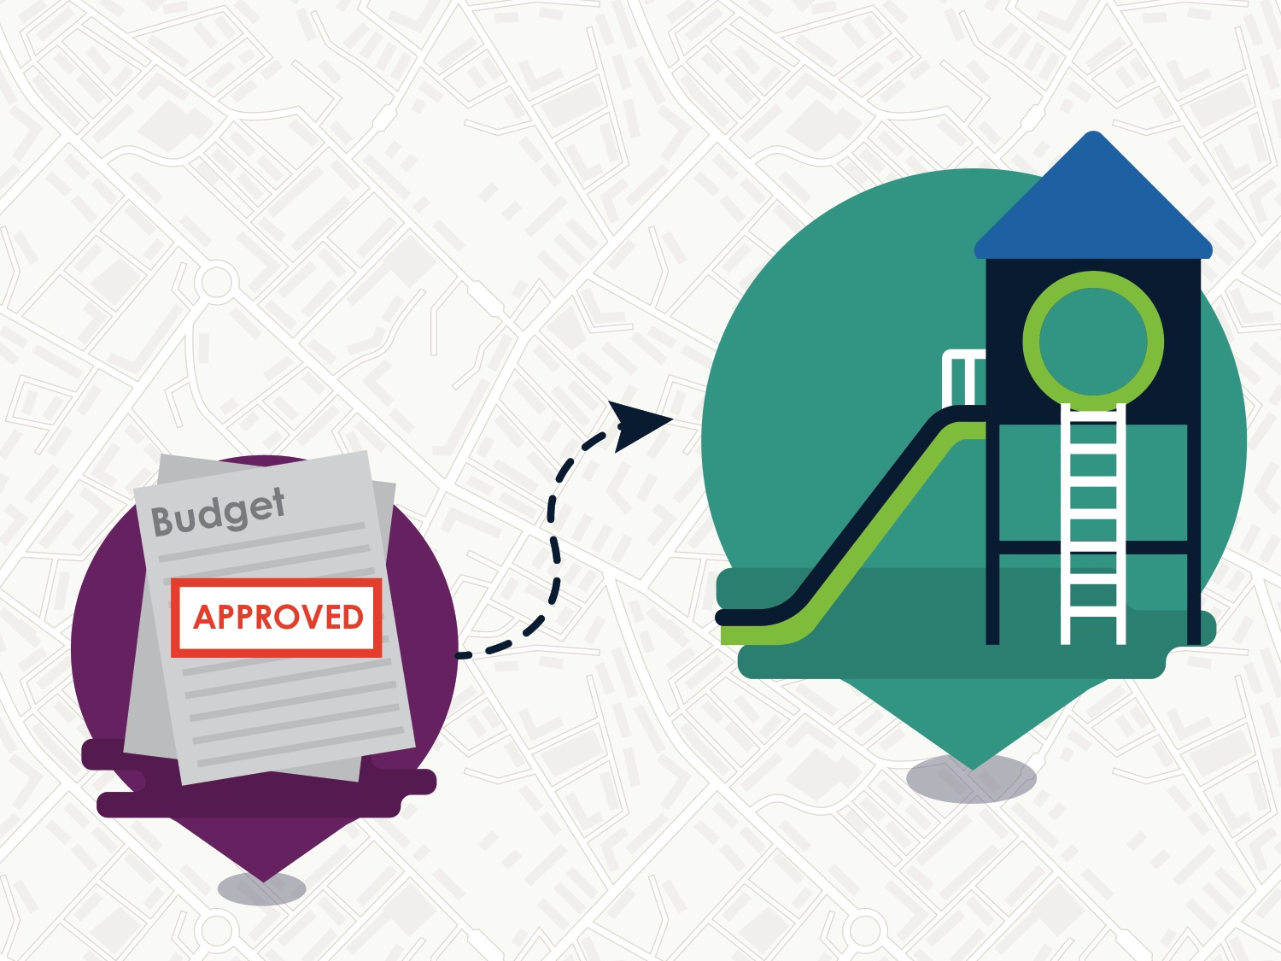
SB-5 $4 billion in bonds for parks & more!
Notes:
Before any budget can be approved, every county department must assess their business plans and annual budget to determine how they will impact equity.

Slide 12
www.changelabsolutions.org /publications/complete-parks

Slide 13
Coming in 2018…
Complete Parks Model Resolution
Notes:
And Policies provide the framework for achieving healthy environments. From access to healthy food, to clean water and air, to physical activity, housing, jobs and schools

Slide 14
Measuring a Complete Park System
Guidance to Assess Your System and Prioritize Elements

Slide 15
The How of Complete Parks
Collaboration across local government agencies
2. Meaningful, ongoing community engagement

Slide 16
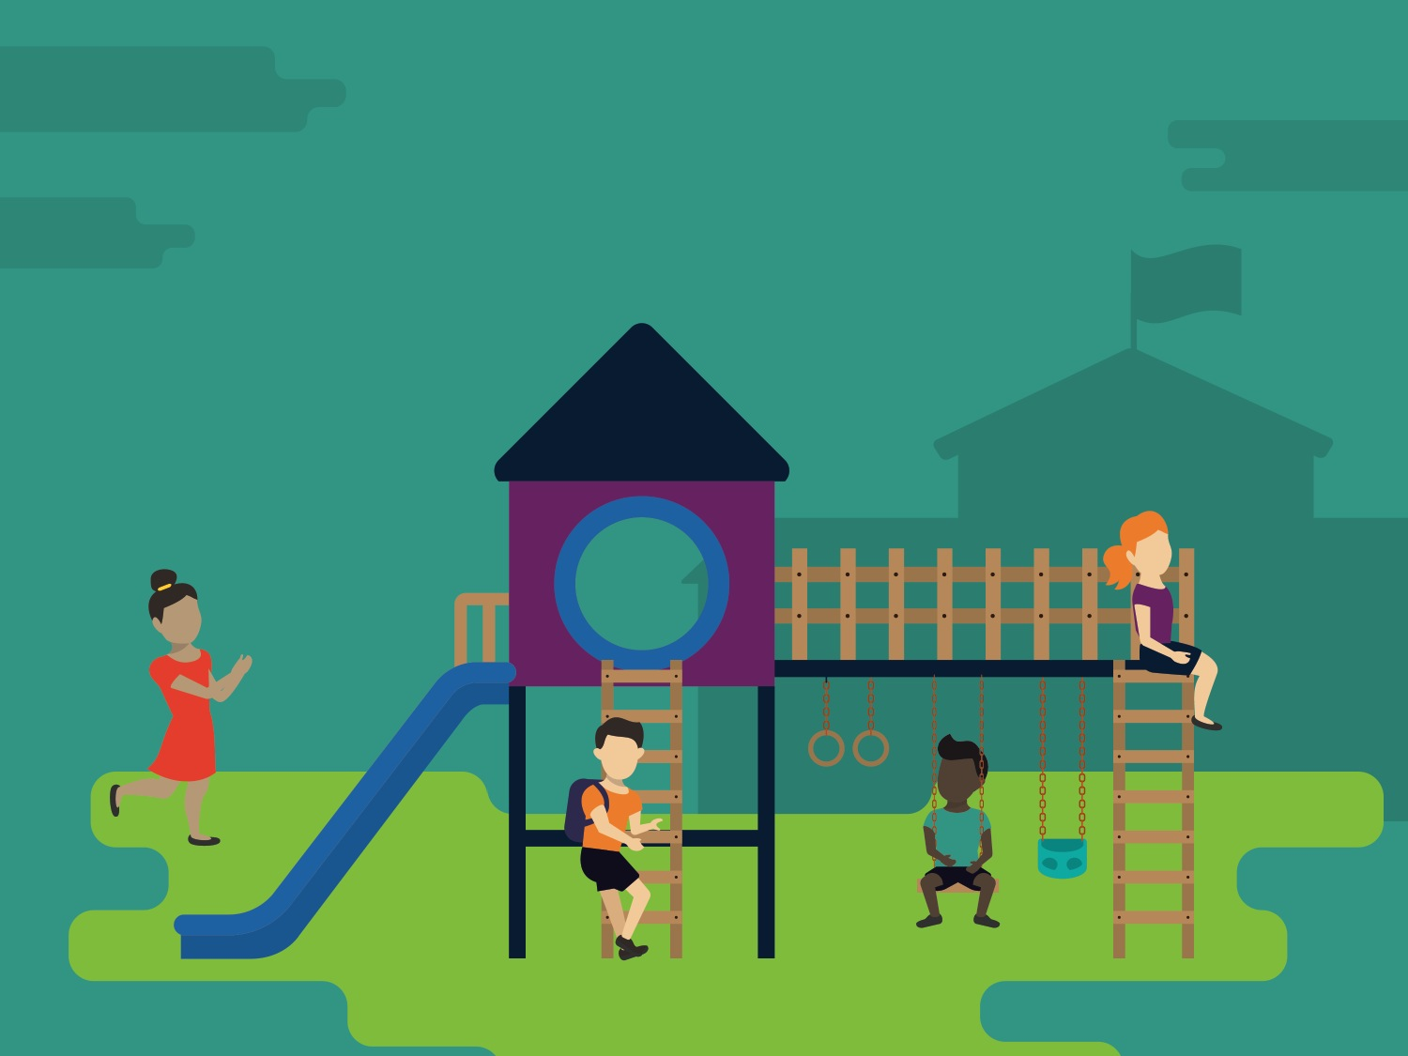
Why Parks?
Notes:
Policies make it possible for our schools to be healthy. By setting standards for what’s served in school cafeterias and vending machines, Whether drinking water is clean and available, Whether school playgrounds are open to community use after school hours, Or whether kids can walk or ride their bikes to school. Which affects what kids eat, how physically active they are, and if they can focus during school.

Slide 17
All sorts of people
enjoy parks in all sorts of ways

Slide 18
Complete Parks

Slide 19
Benita Tsao
btsao@changelabsolutions.org
Get in touch!

