Slide 1
Building A Culture of Health 4 Things in 10 Minutes
Easy, No Cost Actions Your Team Can Start Tomorrow
Karen E. Lyons, MPH
Director, Workforce Health Consulting
Kaiser Permanente

Slide 2
explore the wealth of resources offered through this initiative: Cities for Workforce Health
ACTION #1

Slide 3
Cities for Workforce Health is designed to engage League cities and their employees in building a culture of health and making enhanced health and productivity a reality at the workplace.

Slide 4
Cities for Workforce Health: 4 Initiatives
One-on-One Consulting and Grants
Educational Webinars
Online Resources
Wellness Talk Conference Calls
Help select cities (who have demonstrated readiness and commitment) advance their workforce health strategy via expertise & financial support.
Provide resources for all cities to begin developing and implementing workforce health programs.
Audience: HR Directors, City Wellness Champions, Elected Officials, Wellness Committees, & Other Key City Stakeholders

Slide 5
take your personal well-being self assessment, then Have a book club read; take action personally and at work. Help colleagues thrive how they want to.
ACTION #2

Slide 6
Focus on Well-Being, not just the physical

Slide 7
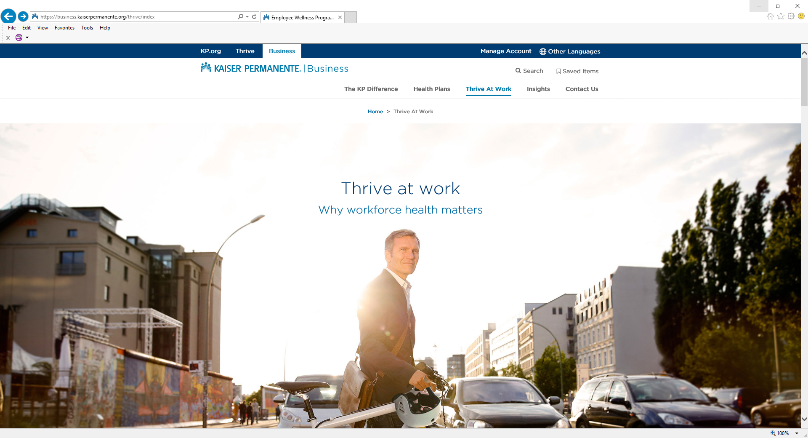
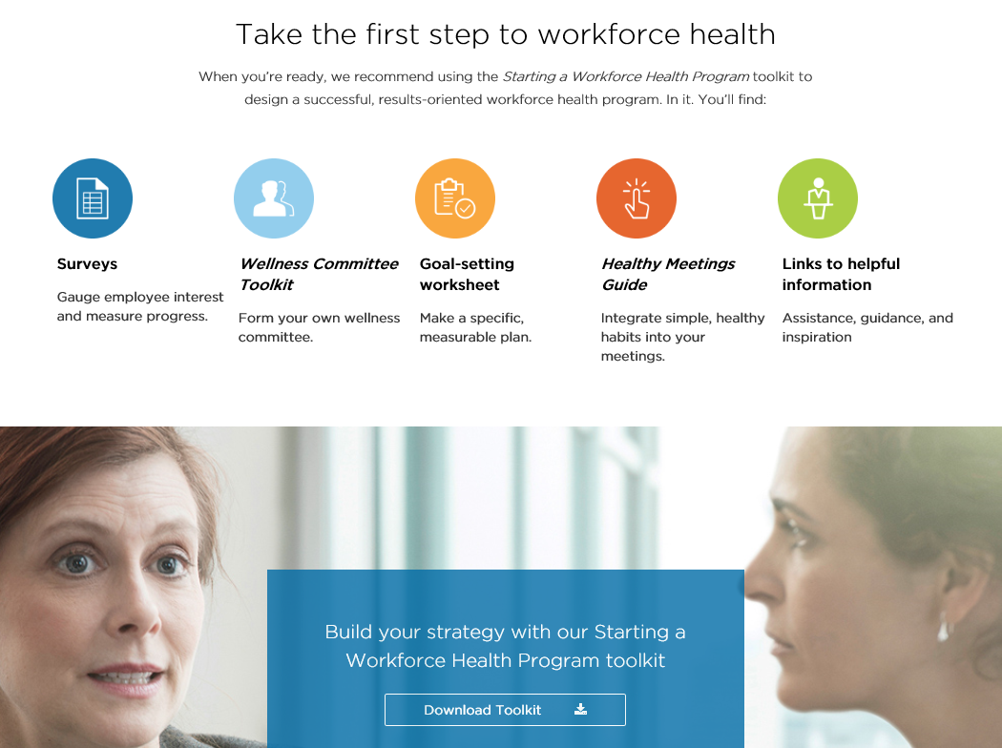
Go to: kp.org/choosebetter. Become familiar with the employer resources built by Kaiser Permanente.
ACTION #3

Slide 8
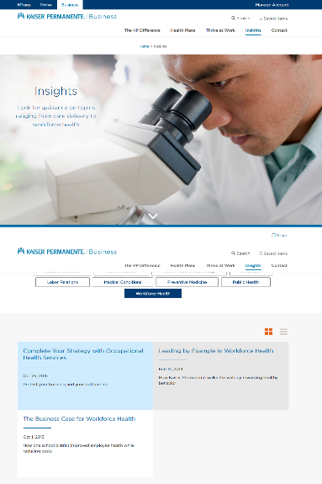
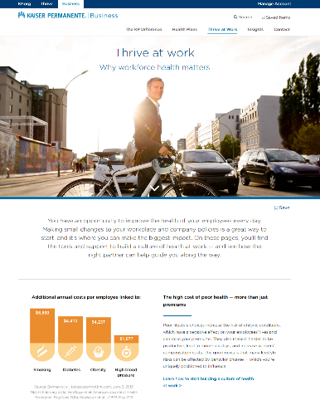
No-cost tools and resources at kp.org/choosebetter
THE IMPORTANCE OF WORKFORCE HEALTH
Interactive toolkits
Starting a Workforce Health Program toolkit
Workforce Health Resource Guide
Healthy Meetings Guide
Maintain Don’t Gain Toolkit
Tobacco-Free Campus Toolkit
Walking for Workforce Health Toolkit
Rest and Revive Toolkit
Healthy Eating at Work food policy toolkit
Resource Center
Insights blog
Notes:
Employers have access to our full range of comprehensive yet easy-to-follow toolkits — available at no cost — to help launch their strategy. We selected the following resources because they’re simple for small businesses to implement. These and others are available at kp.org/choosebetter:
Starting a Workforce Health Program toolkit — lays out the building blocks for beginning a workforce health program
Workforce Health Resource Guide — an overview of resources and tools available for weight management, tobacco cessation, stress and mental health, and heart health
Healthy Meetings Guide — how to make a few small changes at meetings to support overall health and productivity, such as healthier food options and simple stretch breaks
Maintain Don’t Gain Toolkit — a step-by-step guide to encourage employees to make healthier choices to avoid holiday weight gain
Tobacco-Free Campus Toolkit — how to establish policies to make the workplace and company events tobacco-free
Walking for Workforce Health Toolkit — assessment tools, trackers, and communication materials to start a walking program at work
Rest and Revive Toolkit — tools to help employees establish better sleep habits, such as a daytime activity log to show how food, drinks, and activity affect sleep
Healthy Eating at Work food policy toolkit — a guide to developing and implementing a food policy that encourages employees to make healthy choices
The Resource Center at kp.org/choosebetter contains a wealth of useful materials to support your workforce health efforts.

Slide 9
consider the “Maintain don’t gain” campaign for the holidays. Little effort, great engagement and a free “gift” to employees.
ACTION #4

Slide 10
Notes:
Each toolkit starts with an overview of the resources available (Ie: communications via email, marketing via poster, an employee guide with facts and tips, success tracker.

Slide 11
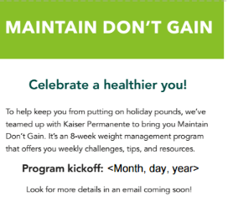
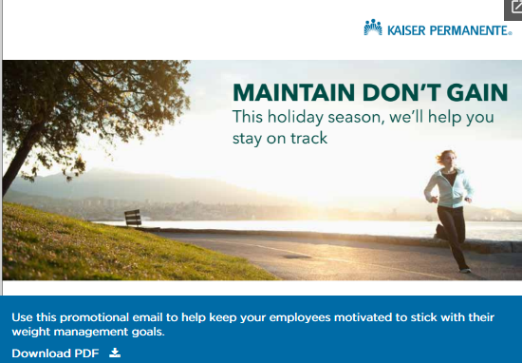
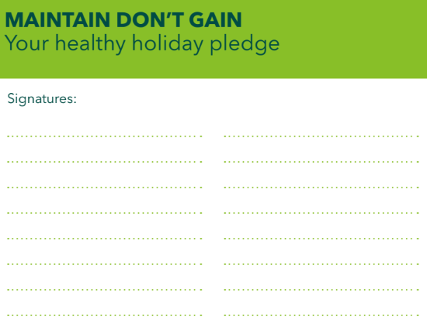
Promotional & Engagement Materials Included
Click Here
Notes:
START PUSH NOTIFICATIONS HERE. Online you will find the promotional flier by accessing the Resource Center and filtering by clicking on “Weight Management” and then scrolling down until you see Maintain Don’t Gain weight management promotional flier. Motivate your employees to take charge of their weight around the holidays by participating in your weight management program.

Slide 12
Push-Ready Weekly Emails
Click Here
Notes:
Online you will find the weekly emails by accessing the Resource Center and filtering by clicking on “Weight Management” and then scrolling down until you see Maintain Don’t Gain weight management program week 1 – week 8 emails.

Slide 13
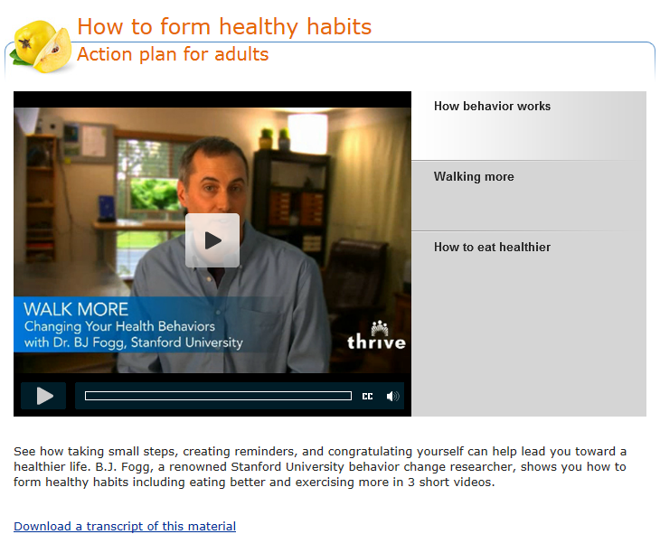
Resources Provided in Emails
Notes:
From the email you send out, your employees can choose to use the resources provided in that week, here is an example of a resource provided

Slide 14
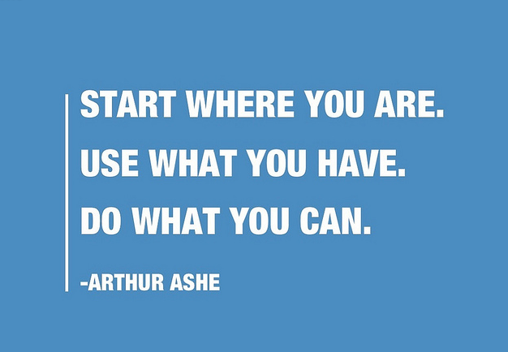
Karen.E.Lyons@kp.org

