Slide 1
BEVERAGE VENDING SURVEY:
FINDINGS FOR THE CITY OF LOMPOC
March 2017

Slide 2
Live Well Santa Barbara County
The primary collaborative focus of Live Well Santa Barbara County is providing health education and advocating for health in all policies and programs. The coalition includes representation from organizations, agencies, and government officials with an interest in nutrition, physical activity, public health, the environment, and health care.

Slide 3
SURVEY RESPONDENTS (N=77)

Slide 4
VENDING MACHINE LOCATION (N=77)

Slide 5
Vending Machine Location (N=77)
32%
23%
12%
8%
6%
Notes:
Government building
Public park
Commercial business
School
Sports field / facility

Slide 6
FINDINGS FOR THE CITY OF LOMPOC

Slide 7
City of Lompoc (N=27)
37%
19%
7%
4%
Notes:
Government building
Water treatment plant
City hall
Department of Social Services
Commercial business
Electric shop in corporate yard
Corporate yard front entrance
V Street Collections breakroom
Vons
Walmart
Sports field / facility
Lompoc Aquatic Center
School
Lompoc Unified School District lounge
La Honda staff lounge

Slide 8
Vending Machine Location
Category: Other (30%, N=8)
Recreation Center
Community and Senior Center
Hospital
Healthcare Organization
After School Program Building
Notes:
Recreation Center
Anderson Recreation Center
Community and Senior Center
Dick DeWees Community and Senior Center
Hospital
Healthcare Organization
Lompoc Valley Healthcare Organization
After School Program Building
United Boys & Girls Club

Slide 9
Type of Beverages in vending machine

Slide 10
Types of BEVERAGES in vending machine
Average Size
Average Price
Soda
12 ounces
On average, 39 grams of sugar
Sports Drinks
20 ounces
On average, 36 grams of sugar
Water
20 ounces
On average, 30% of daily serving
Soda
$1.00 - $1.99
Sports Drinks
$2.00 - $2.99
Water
$1.00 - $1.99

Slide 11
Government building (N=10)
TYPES OF BEVERAGES AVAILABLE
37%

Slide 12
Commercial business (N=5)
TYPES OF BEVERAGES AVAILABLE
19%
Notes:
4 vending machines located at Walmart
1 vending machine at Vons

Slide 13
SPORTS FIELD or FACILITY (n=2)
TYPES OF BEVERAGES AVAILABLE
7%
Notes:
2 vending machines at Lompoc Aquatic Center

Slide 14
School (N=1)
TYPES OF BEVERAGES AVAILABLE
4%
Notes:
One vending machine located at La Honda Elementary School (staff lounge)

Slide 15
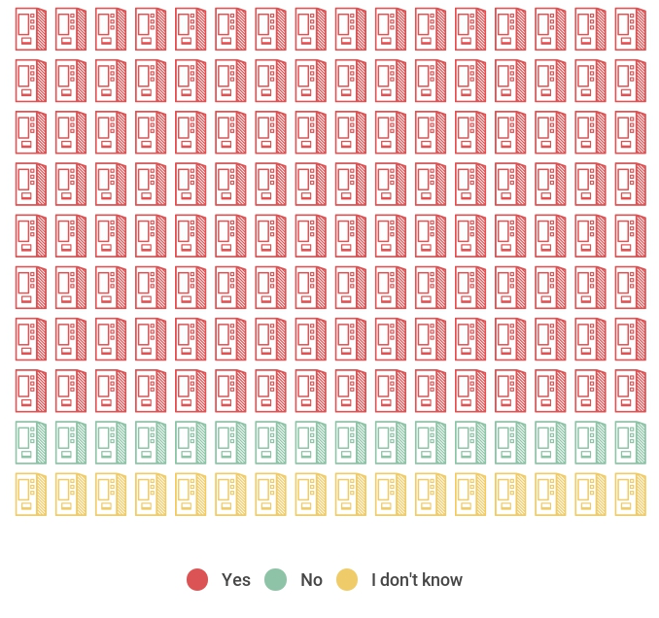
Visible advertising
Visible Advertising
80%
10%
10%

Slide 16
VISIBLE ADVERTISING
Notes:
Other includes Coca-Cola or Pepsi logo with commercial brand (Walmart) or multiple, small logos

Slide 17
TOOLKIT AVAILABLE AT:
www.livewellsbc.org

