Slide 1
BEVERAGE VENDING SURVEY:
FINDINGS FOR THE CITY OF SANTA MARIA
March 2017

Slide 2
Live Well Santa Barbara County
The primary collaborative focus of Live Well Santa Barbara County is providing health education and advocating for health in all policies and programs. The coalition includes representation from organizations, agencies, and government officials with an interest in nutrition, physical activity, public health, the environment, and health care.

Slide 3
SURVEY RESPONDENTS (N=77)

Slide 4
VENDING MACHINE LOCATION (N=77)

Slide 5
Vending Machine Location (N=77)
32%
23%
12%
8%
6%
Notes:
Government building
Public park
Commercial business
School
Sports field / facility

Slide 6
FINDINGS FOR THE CITY OF SANTA MARIA

Slide 7
City of Santa Maria (N=27)
52%
22%
7%
7%
Notes:
Public park
Government building
Commercial business
Sports field / facility

Slide 8
Type of Beverages in vending machine

Slide 9
Types of BEVERAGES in vending machine
Average Size
Average Price
Soda
12 ounces
On average, 39 grams of sugar
Sports Drinks
20 ounces
On average, 36 grams of sugar
Water
20 ounces
On average, 30% of daily serving
Soda
$1.00 - $1.99
Sports Drinks
$2.00 - $2.99
Water
$1.00 - $1.99

Slide 10
PUBLIC PARK (N=14)
TYPES OF BEVERAGES AVAILABLE
52%
Notes:
Fletcher Park
Rotary Park
Abel Maldonado Community Youth Center
Veteran’s Hall and Park
Atkinson Park and Community Center
Jim May Park
Buena Vista Park
Adams Park
Preisker Park
Miramonte Park and Recreation Building

Slide 11
Government building (N=6)
TYPES OF BEVERAGES AVAILABLE
22%
Notes:
Benefit Service Center
Workforce Resource Center (WRC)
Department of Social Services
North County Health Care Clinic
Betteravia Social Services Building

Slide 12
Commercial business (N=2)
TYPES OF BEVERAGES AVAILABLE
7%
Notes:
Costco
Vallartas Market

Slide 13
Sports field or facility (N=2)
TYPES OF BEVERAGES AVAILABLE
7%
Notes:
Minami Community Center and Park
Hageman Sports Complex

Slide 14
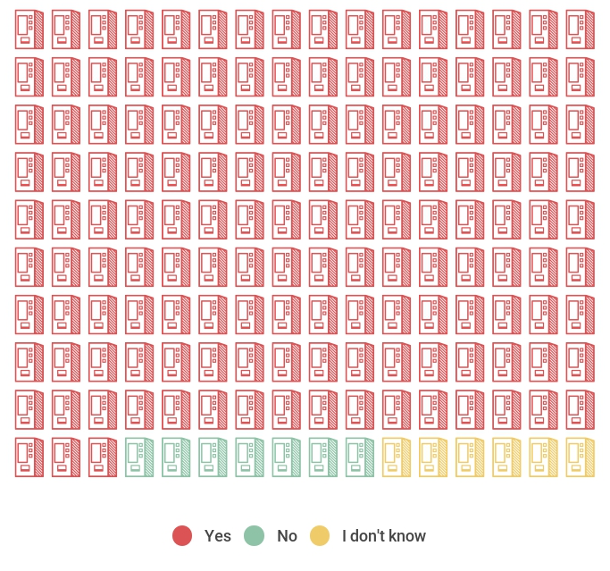
Visible advertising
Visible Advertising
92%
4%
4%

Slide 15
VISIBLE ADVERTISING
Notes:
Other = one machine has Minute Maid and the other has soda advertisements

Slide 16
TOOLKIT AVAILABLE AT:
www.livewellsbc.org

