Slide 1
FINDINGS FROM BEVERAGE VENDING SURVEY
March 2017

Slide 2
SURVEY RESPONDENTS

Slide 3
VENDING MACHINE LOCATION (N=77)

Slide 4
Vending Machine Location (N=77)
32%
23%
12%
8%
6%
Notes:
Government building
Public park
Commercial business
School
Sports field / facility

Slide 5
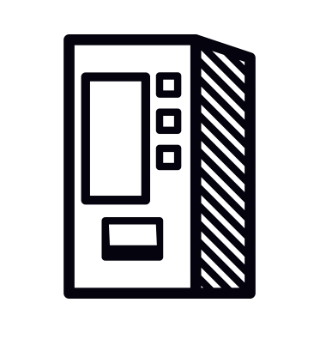
Vending Machine Location
Category: Other (19%, N=13)
College or university
Early care or day care center
Private office building
Recreation centers
Hospitals
Senior centers

Slide 6
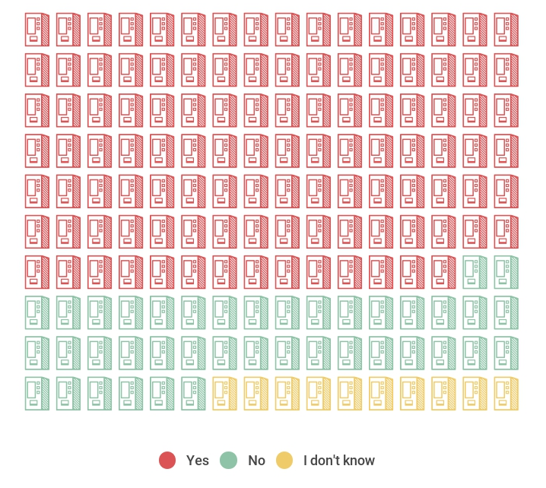
VENDING MACHINE LOCATION
More than One Vending Machine in the same location
69%
25%
6%

Slide 7
Type of Beverages in vending machine

Slide 8
Government buildings
TYPES OF BEVERAGES AVAILABLE
32%
Notes:
48% of vending machines (included in survey) at government buildings located in Lompoc
86% of vending machines at government buildings are of more than one in a location

Slide 9
PUBLIC PARKS
TYPES OF BEVERAGES AVAILABLE
23%
Notes:
93% of vending machines (included in survey) at public parks located in Santa Maria
47% of vending machines at public parks are of more than one in a location

Slide 10
Commercial businesses
TYPES OF BEVERAGES AVAILABLE
12%
Notes:
71% of vending machines (included in survey) at commercial businesses located in Lompoc, 29% in Santa Maria
86% of vending machines at commercial businesses are of more than one in a location

Slide 11
schools
TYPES OF BEVERAGES AVAILABLE
8%
Notes:
5 schools included in survey results (2 in Buellton, 1 in Lompoc, 1 in Santa Maria, 1 in Santa Ynez)
60% of vending machines at schools are of more than one in a location

Slide 12
BEVERAGES
Average Size
Average Price
Soda
12 ounces
On average, 39 grams of sugar
Sports Drinks
20 ounces
On average, 36 grams of sugar
Water
20 ounces
On average, 30% of daily serving
Soda
$1.00 - $1.99
Sports Drinks
$2.00 - $2.99
Water
$1.00 - $1.99

Slide 13
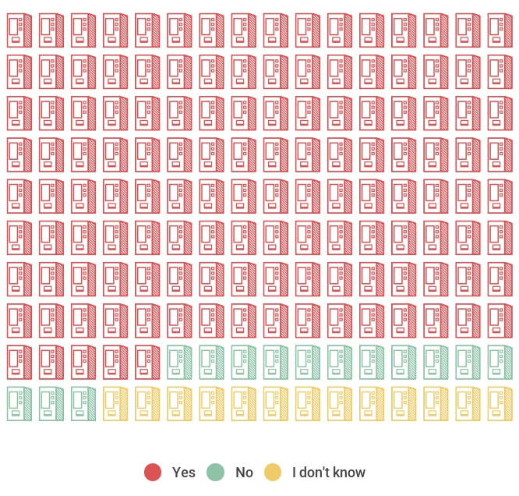
Visible advertising
Visible Advertising
83%
9%
8%

Slide 14
VISIBLE ADVERTISING

Slide 15
CITY OF SANTA MARIA (41%)
TYPE OF LOCATION OR FACILITY
TYPE OF BEVERAGE ADVERTISED ON VENDING MACHINE
52%
22%

Slide 16
CITY OF SANTA MARIA (41%)
TYPE OF BEVERAGES AVAILABLE
MORE THAN 1 VENDING MACHINE IN SAME LOCATION

Slide 17
CITY OF LOMPOC (41%)
TYPE OF LOCATION OR FACILITY
TYPE OF BEVERAGE ADVERTISED ON VENDING MACHINE
37%
19%
Notes:
The 53% of other in beverage advertised include several small logos, banner logos, and logos with commercial business (i.e. Walmart) all including soda (regular)

Slide 18
CITY OF LOMPOC (41%)
TYPE OF BEVERAGES AVAILABLE
MORE THAN 1 VENDING MACHINE IN SAME LOCATION

Slide 19
TOOLKIT AVAILABLE AT:
www.livewellsbc.org

