Slide 2
Building Food and Nutrition Literacy: Education Resources for Schools
Bessie O’Connor, RDN
Community Nutrition Adviser
Santa Barbara School Wellness Summit 2021

Slide 3
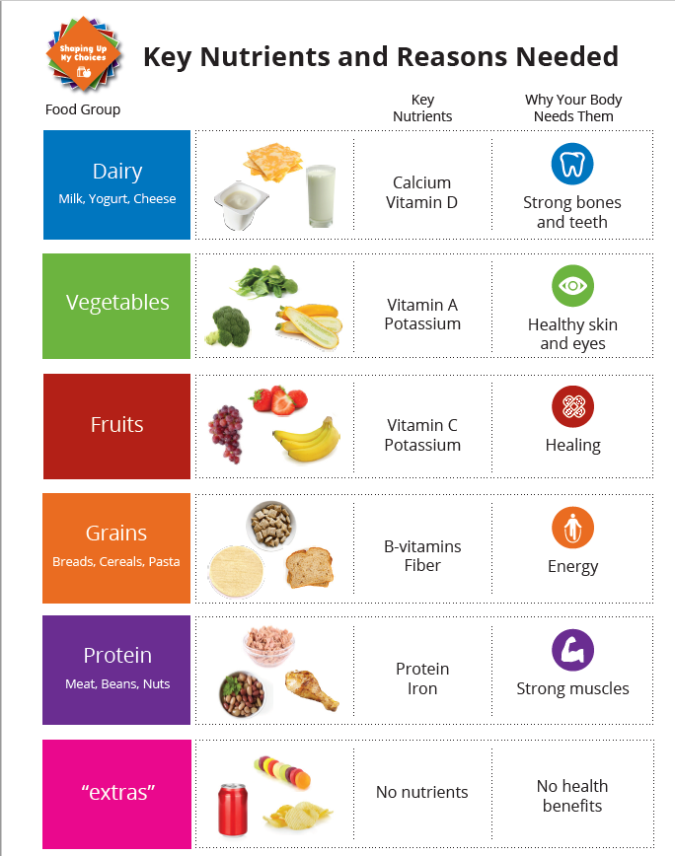
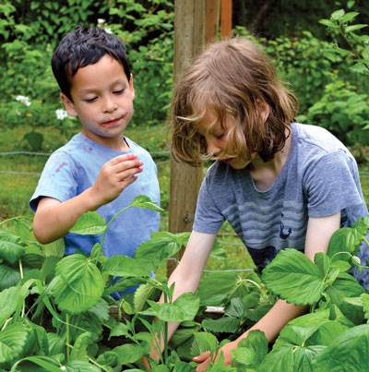
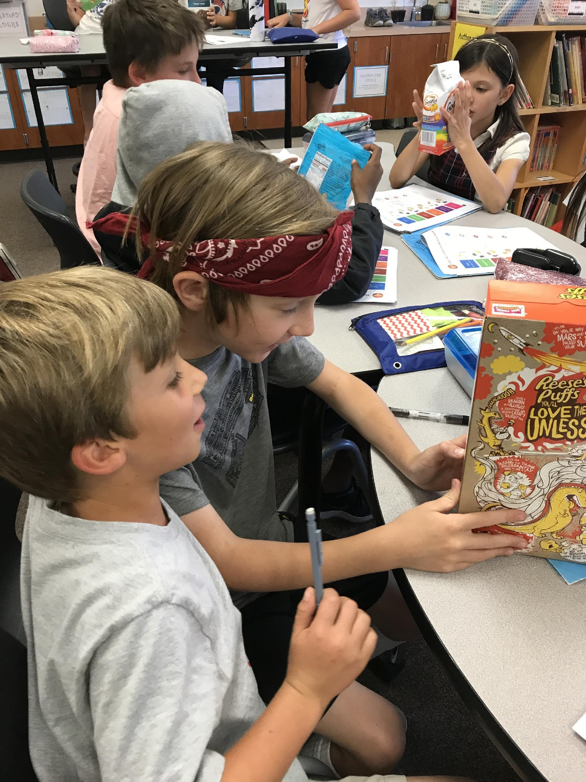
Food & Nutrition Literacy
Notes:
.

Slide 4
Let’s Eat Healthy
Nutrition Education Curriculum
Grade specific K-12
Aligns to Common Core Standards
Based on the Dietary Guidelines for Americans
Curriculum consists of teacher guide + student workbook
Parent materials
Available in English & Spanish
Free in CA

Slide 5
Nutrition Education can Help with Access to Food

Slide 6
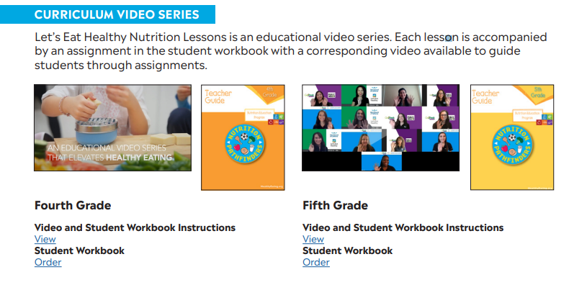
Let’s Eat Healthy
4th & 5th grade video series

Slide 7
Videos, Games, and Activities

Slide 9
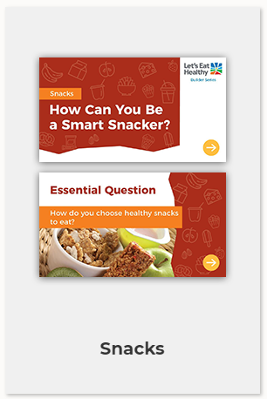
Online Nutrition Builder Series

Slide 10
Print Nutrition Builders

Slide 11
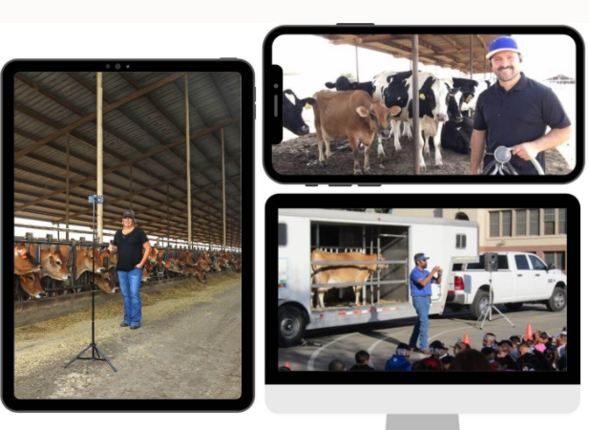
Farm to School

Slide 12
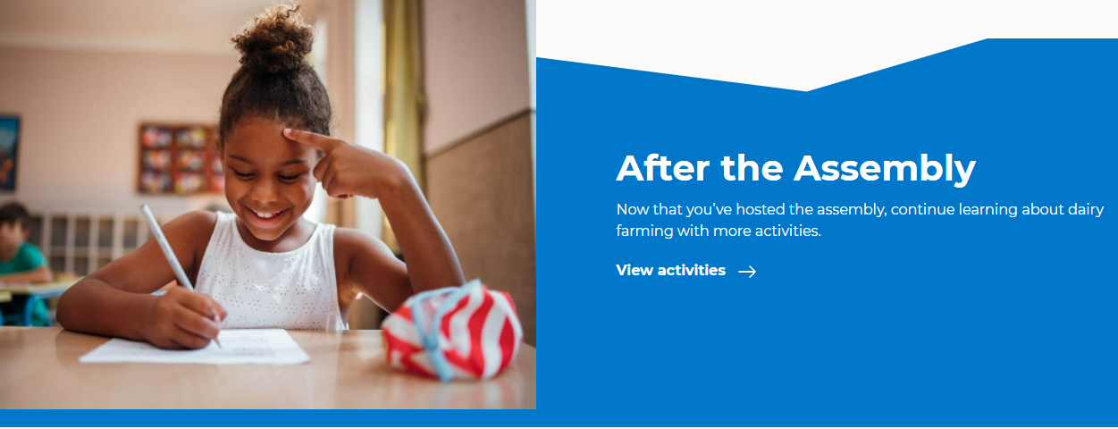
Farm to School

Slide 13
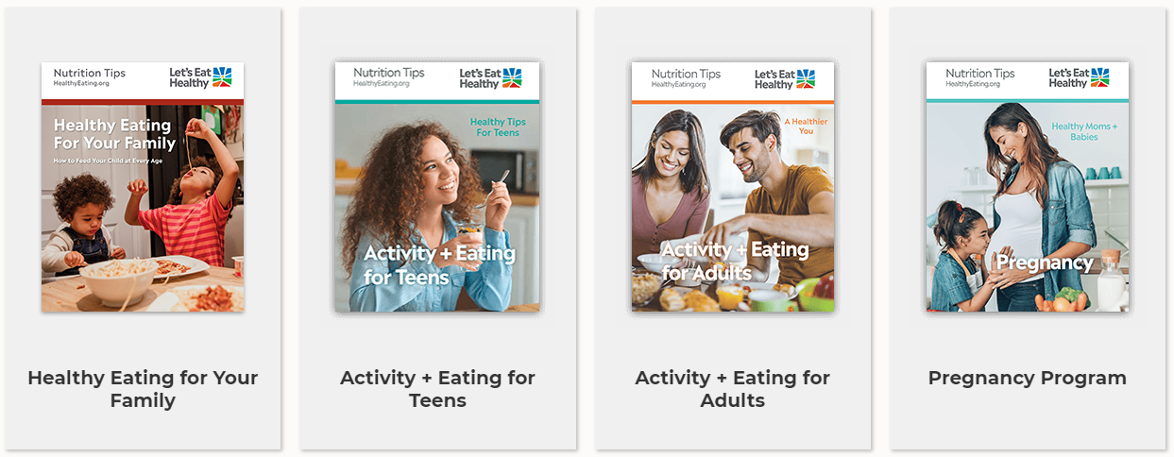
Adult & Family Nutrition Resources

Slide 14
Ask A Nutritionist Vlog series

Slide 15
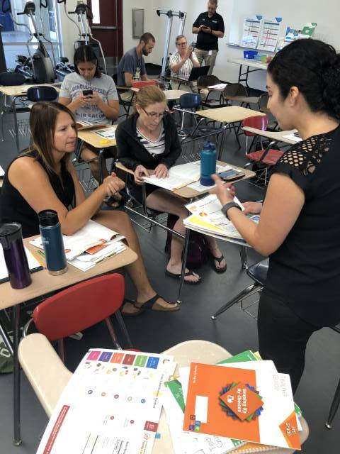
Training & Advising
LSWP technical advising
Parent & family nutrition education
Professional Development
Innovative wellness strategies

Slide 16
School Food Service
Professional Development
Nutrition Education: The Vital Role of of Nutrition Professionals
Taking Care of Yourself: For School FoodService Professionals During Stressful Times

Slide 17
Smarter Lunchrooms

Slide 18
Bringing it all together

Slide 20
Join the Let’s Eat Healthy Movement!
HealthyEating.org/Join

Slide 21
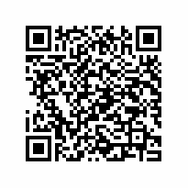
Bessie O’Connor
BOconnor@HealthyEating.org
805.320.0890

